Slide 1
Communication Network Analysis
COMMS 503 / Nakho Kim

Slide 2
Why Communication & Networks?
Agent: entity that acts with own agency.
Network: The totality of connections between agents in a construct.
Social network: agents are people, connections are relations.
Communication: often, what flows through those relations.
Hence, networks can give answers to questions on the structure of communication.

Slide 3
Structuralist approach
I.e. social structure influences how members inside the structure act.
As qualitative idea: cultural studies with critical reflection, emphasizing political economy
As quantitative idea: quantifying the structure to draw rigorous analyses of that structure.

Slide 4
Units
Node (aka vertex, in graph): agents
Coded traits
Network roles, as analyzed (connectors, mavens, leaders, bridges, isolates…)
Edge (aka arc, in graph): connections
Directionality, intensity, probability

Slide 5
Results of network analysis
Visual representation (“graph”)
Relying on pattern seeking
Case: https://cyber.harvard.edu/publications/2017/08/mediacloud
Browsing: http://oxfordinternetinstitute.github.io/InteractiveVis/network/#
Mathematical statistics
Measurements: How centralized? How wide/efficient? How robust? How clustered? Etc.

Slide 6
Strength:
Structural approach, leading to some generalizability
Quantified results, enabling easier comparisons
Good for finding co-occurrence
Weakness:
Autonomous choice of each agent is disregarded
Influencing variables beyond defined networks get lost
Difficult to test causality, even in a time-series

Slide 7
Comm Network and Performance
Leavitt’s network experiment (1957)
Classic study on structure effects (soc psy / org comm)
Limited communication puzzle performance
 | Wheel | Y | Chain | Circle
Speed | 1 highest | 2 | 3 | 4
Leader emerges | Y | Y | So-so | No
Satisfaction | 4 | 3 | 2 | 1 highest

Slide 8
Measurements
Connections
Number of ties: in-degree, out-degree
Homophily
Multiplexity: multi-layer connection
Reciprocity: bidirectional relation
Network closure: relational triads
“Simmelian tie”: triadic (or more) ties have a completely different social function versus 1-to-1 ties

Slide 9
Distributions
Degree Centrality: number of direct connections
Betweenness Centrality: how much it binds (e.g. number of shortest connections to others)
Closeness Centrality: path-length to all other nodes
Eigenvalue Centrality: # of direct connections + # of connections of directly connected ones
Density: actual / all potential connections
Average distance
Tie strength
“The Strength of Weak Ties” (Granovetter): Nodes with more weak (e.g. inter-clique) ties become more efficient.
Yes, it’s a quantitative analysis (not just visual detection)

Slide 10
Segmentation
Clustering coefficient: similarity in network position
Community detection: Finding (near-) cliques
http://kenlau177.github.io/images/my-ego_wtc.png
Cohesion: multi-layered common clustering

Slide 11
Co-occurrence
Just analyzing co-occurrence can yield meaningful patterns (if going really deep)
Example: flavor network (Ahn, 2011)

Slide 12
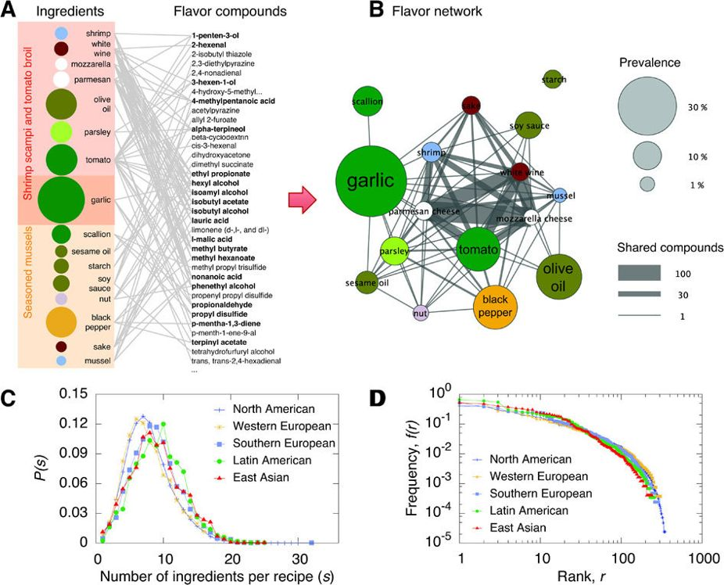

Slide 13
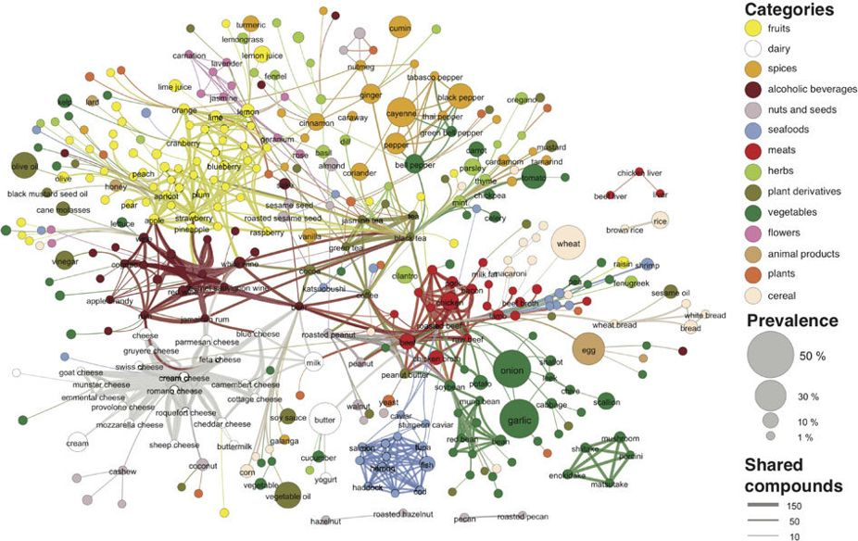

Slide 14
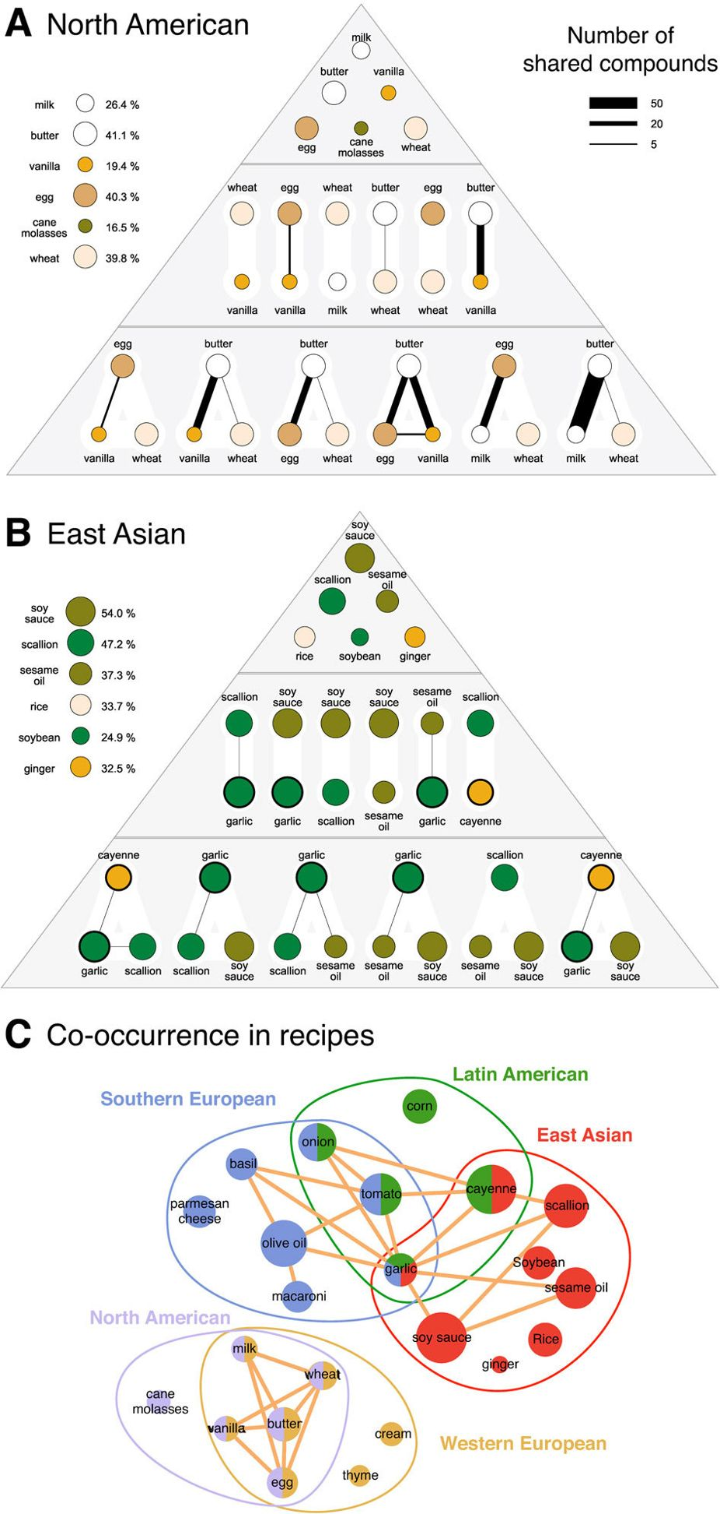

Slide 15
Popular Network Types
Random network (Erdős–Rényi model)
Constant, uniform distribution. But real-world?
Scale-free network (Barabasi)
Dominant hub nodes and long tails (“The degree distribution follows a power law”) e.g. internet.
Small-world network (Watts-Strogatz)
High clustering, small path length e.g. Kevin Bacon game.

Slide 16
Comm Network Research Topics
Collective action
Contagion
e.g. innovation, information flow, etc
Dependency
Sorting out (dynamic)
Coevolution (dynamic)
See more: Monge & Contractor, 2003: Theories of Communication Networks

Slide 17
“What if”
Analyzing scenarios with / without nodes / edges of interest
Crucial for building hypotheses and other planning
Thought experiment
Example: news project grant network
My own in-process graph, as part of Friedland & Koeniczna (2011)

Slide 18
Some patterns in comm network behavior
Bursts (Barabasi)
“Sudden escalation in our activity pattern“ (instead of constant increments)
Dunbar number (Dunbar)
150.
"the number of people you would not feel embarrassed about joining uninvited for a drink if you happened to bump into them in a bar“

Slide 19
Tools of the Trade
NodeXL
Plugin for MS Excel. Also calculates.
Gephi
Graph visualizer language.
Tableau
User-friendly package.
R (stat language)
The full deal.

Slide 20
The Process
Coding the Data
Agents
Traits of agents
Network A
Traits of links
Presence and intensity of links
Network B
…repeat
Analyzing
Visualizing

