Slide 1
Interfaces
Gaming and Interactive Media Week 8
PSH COMM 190 SP23
Nakho Kim

Slide 2
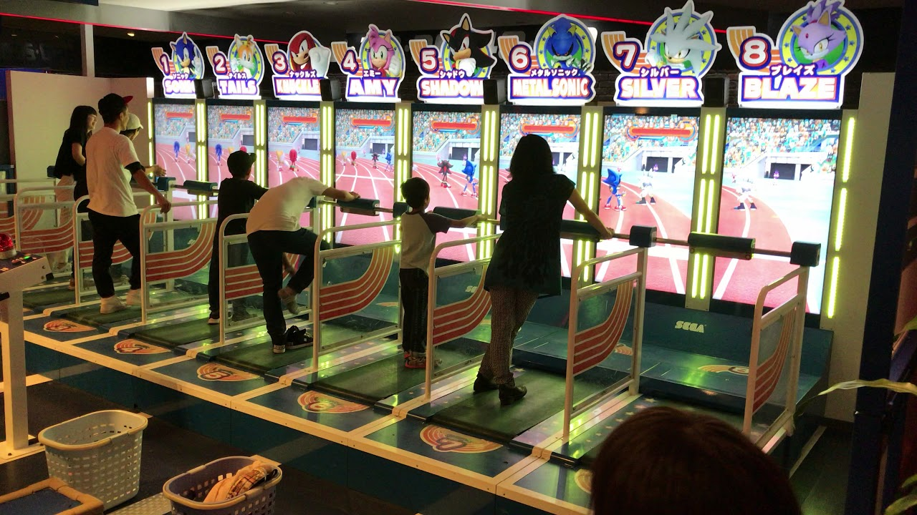
Sonic Athletics (2013) http://tokyo-joypolis.com/attraction/2nd/athletics.html

Slide 3
Interface: the mode(s) in which different entities can interact
Game interface: how the player can interact with the in-game world (incl. other human players)
  HCI (Human Computer Interface)
  Game UI design

Slide 4
Elements of Input
Elements of Output
The Holy Grail: immersive environment (e.g. VR/ AR)

Slide 5
Elements of Good Input Interface
Reaction speed!
  Reducing the time lag between intent and action
Lags occur when…
  Players need to remind themselves of the buttons
  The input device does not register fast reaction
Consider
  Small, stable and quick movement as input
  High tactility

Slide 6
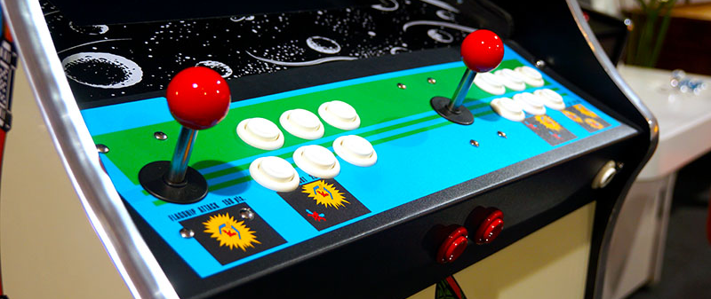
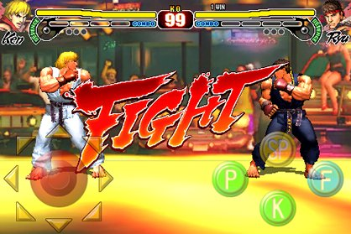
Good
Bad

Slide 7
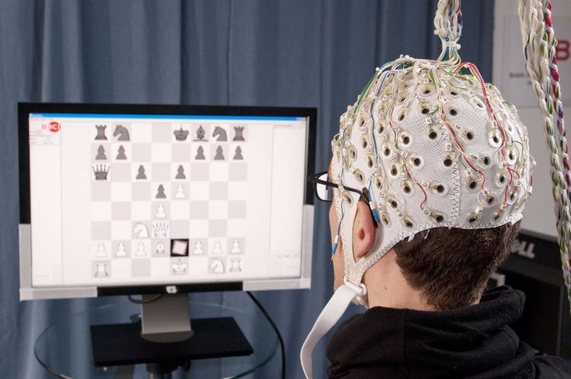
Zero lag time? EEG-based controllers
https://blog.adafruit.com/2016/03/30/brain-computer-interface-lets-you-control-iot-devices/

Slide 8
Precision control!
  Capability to micro-manage the action
Control becomes clumsy when…
  Selecting the intended parts for action is hard
    Especially in multi-unit control games
  Commands are complicated while vague
    E.g. Special attacks in fight games
Consider
  Customization for finer control: custom keyboards, adaptive controllers…

Slide 9
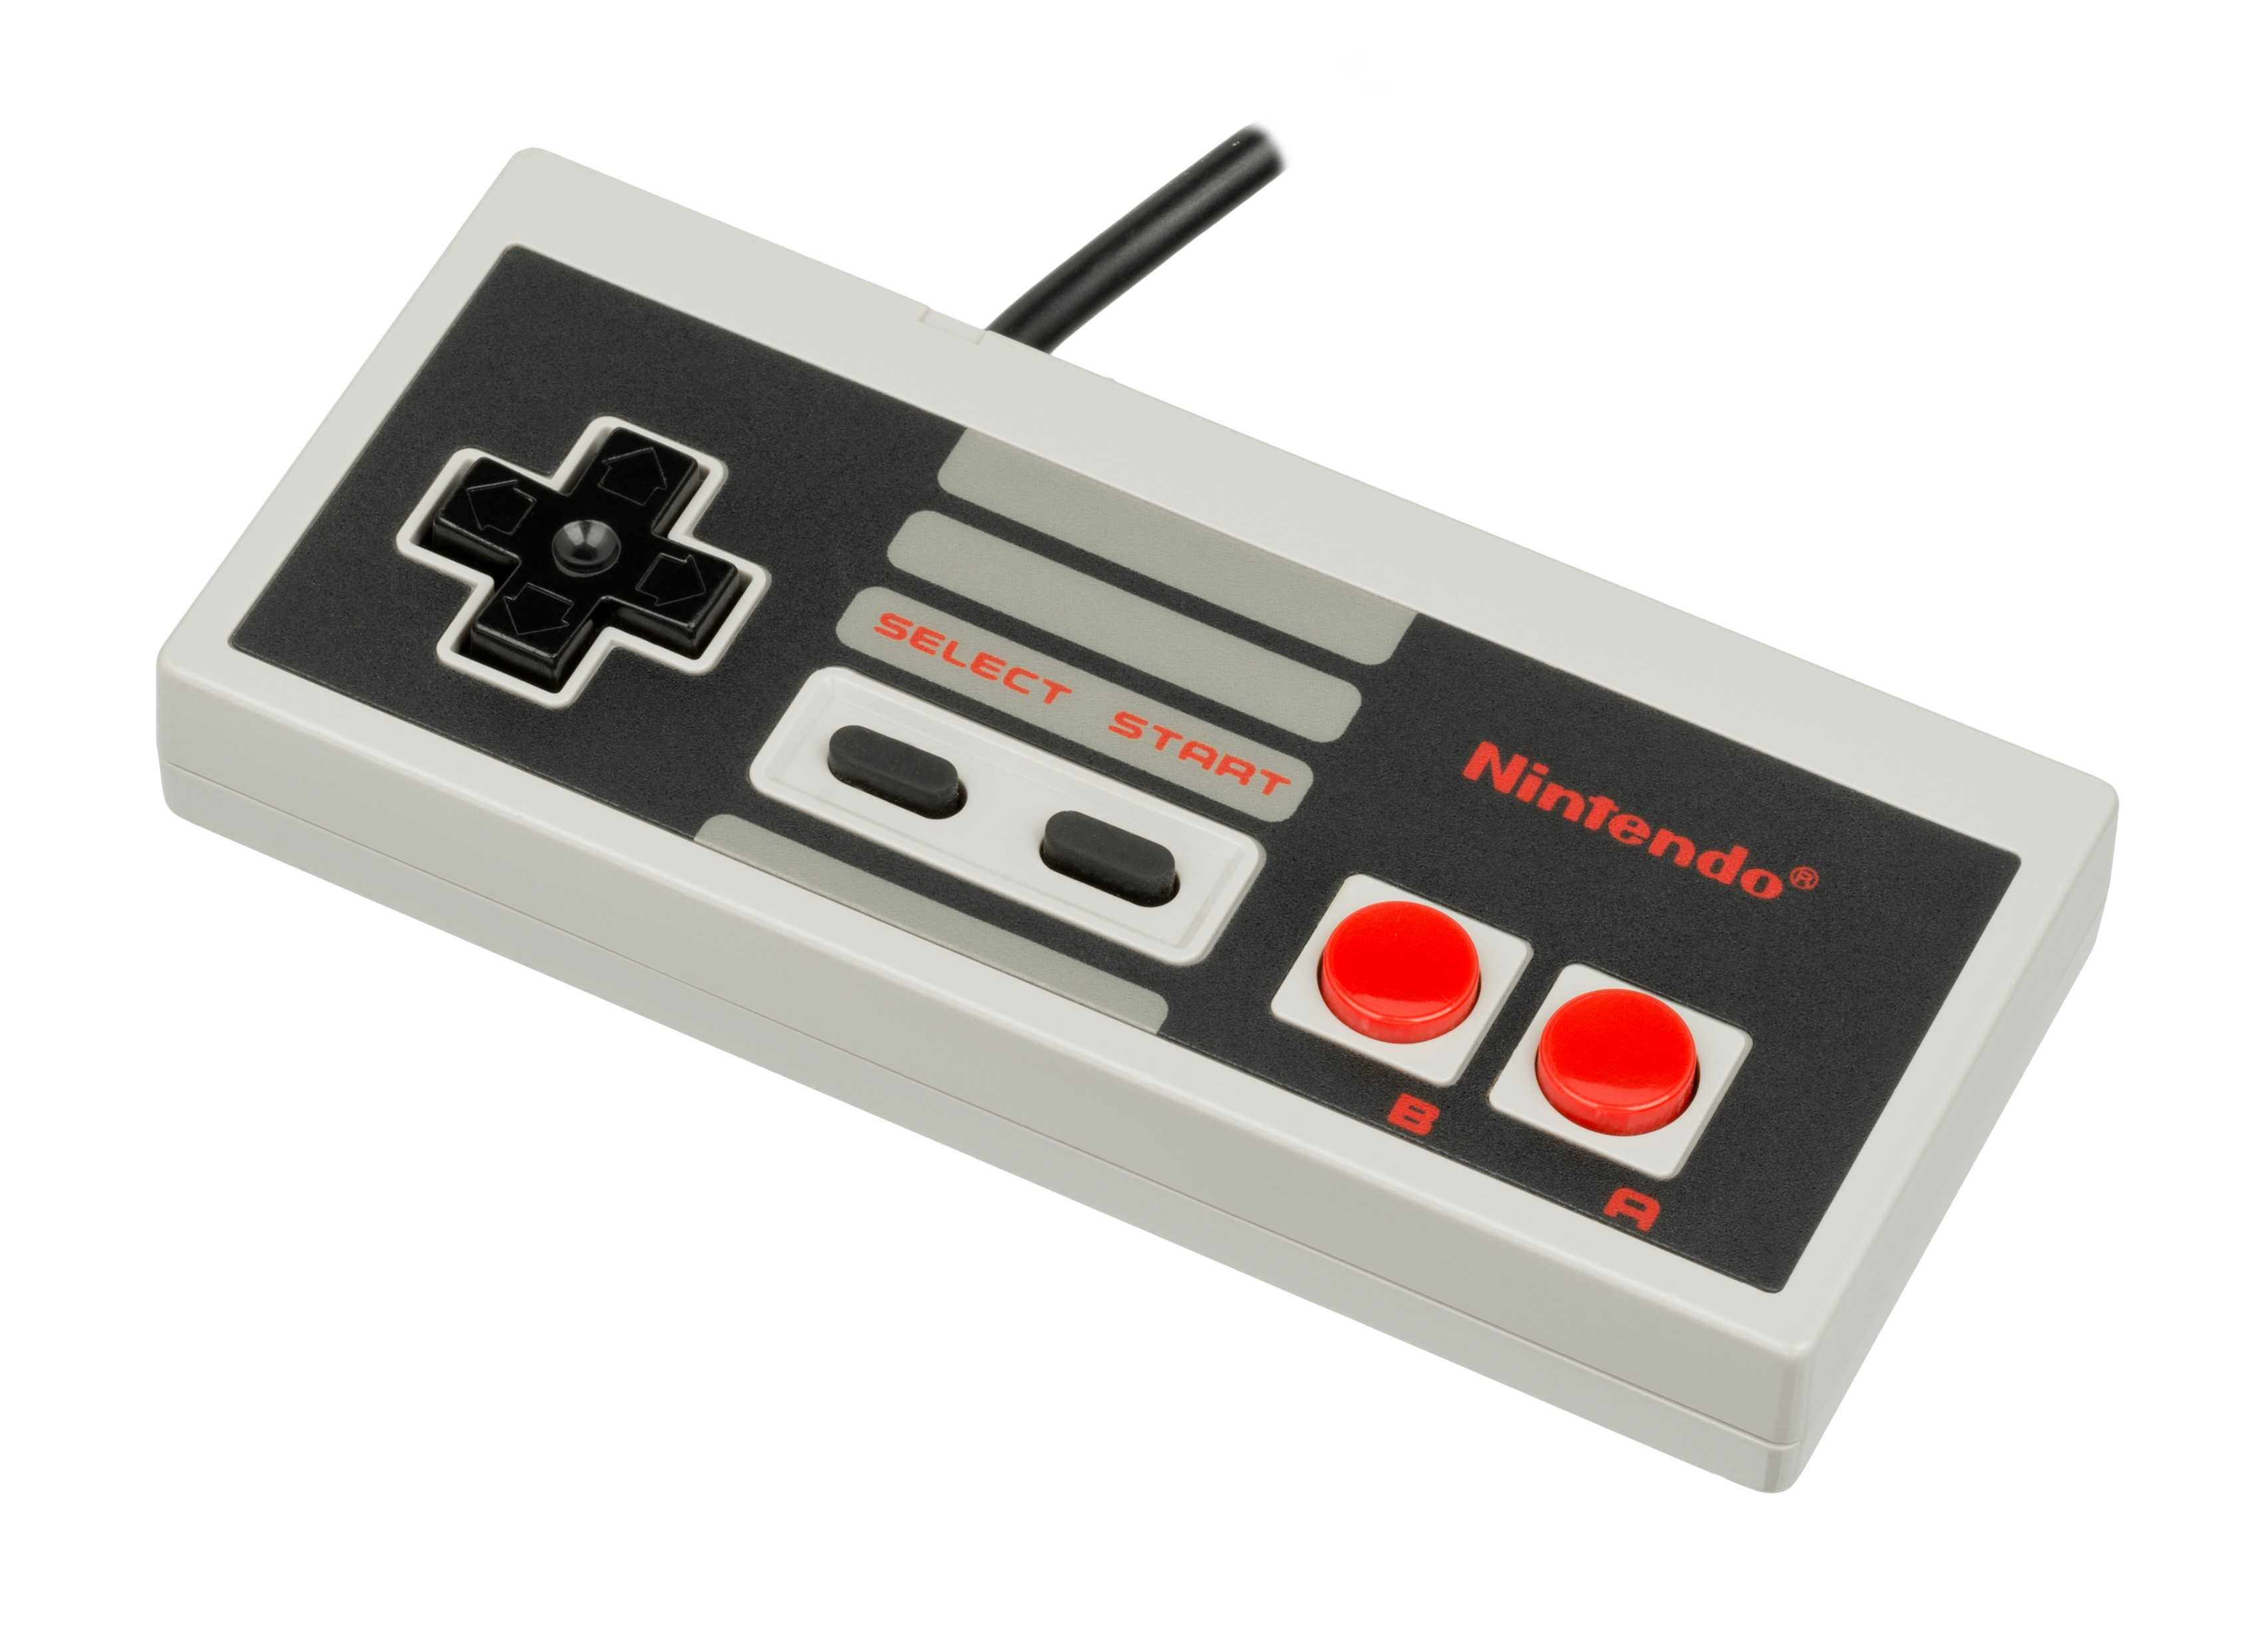
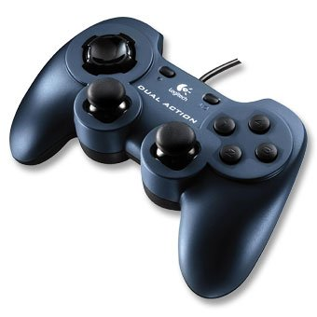
HP Ch 32 (D-pad)

Slide 10
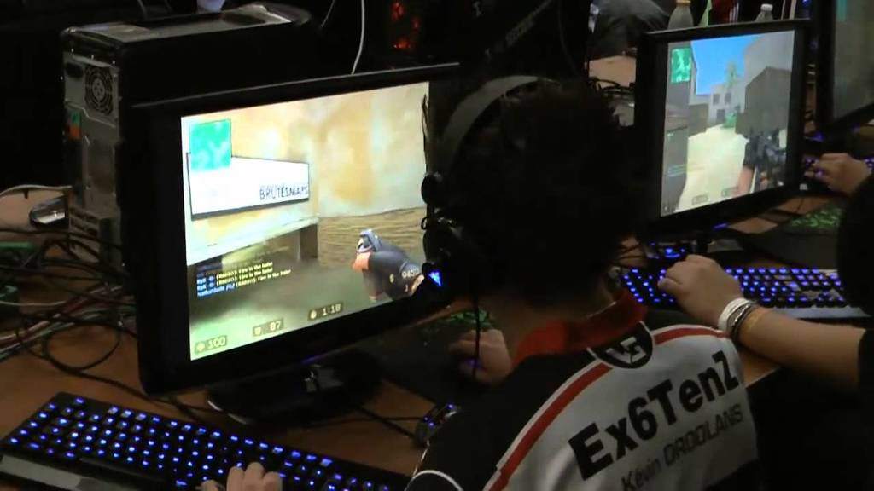
Precision FTW https://www.youtube.com/watch?v=CJLornB6zV0

Slide 11
Intuitiveness!
  Input methods need to be understood intuitively.
Popular approaches include:
  Familiarity
    E.g. Standard gamepad
  Mimicking the real

Slide 12
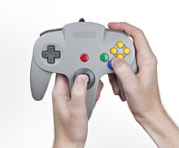
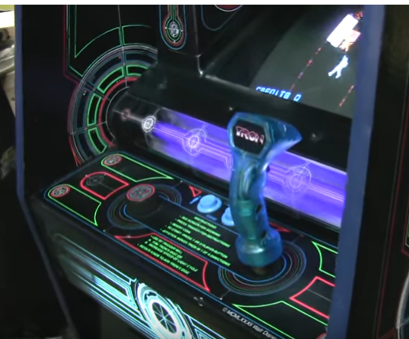
…Just WHY?
Dial & joystick: ancestor of complex control

Slide 13
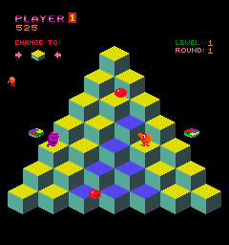
Q-bert: why so hard?
  https://archive.org/details/arcade_qbert
  Press 1 for coins, use arrows to control

Slide 14

  Actually,

Slide 15
Mimicking the real
  Skeuomorphism: designing interface objects mimicking real-life counterparts (term often used in GUI)
  Real action: touch stuff! move your body!
  But needs to be somewhat easier to do than the real thing.

Slide 16
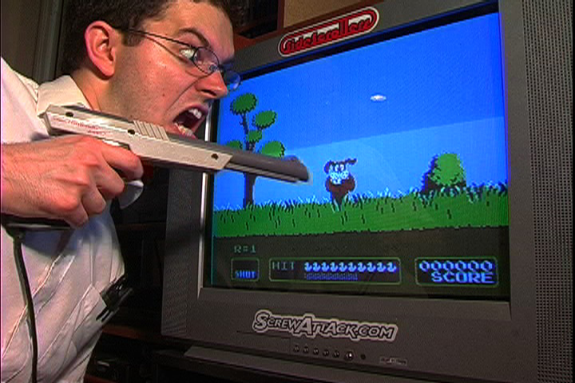
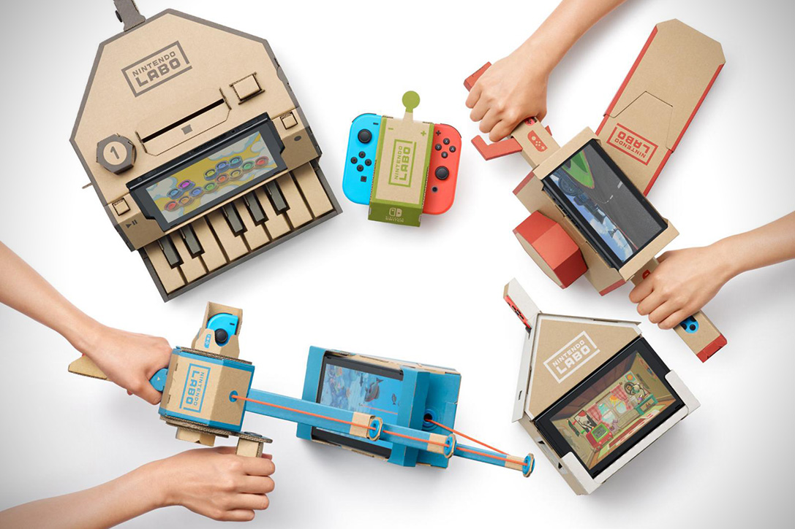

Slide 17
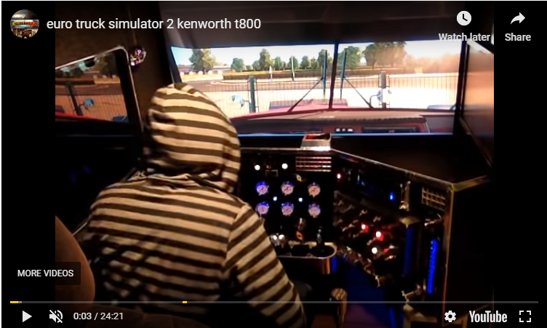

Slide 18
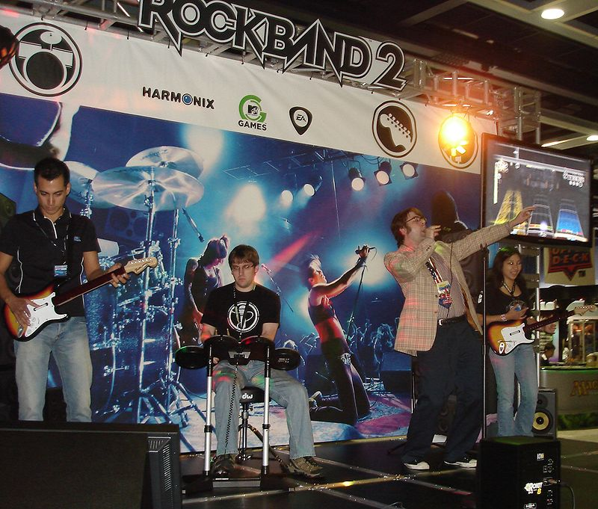
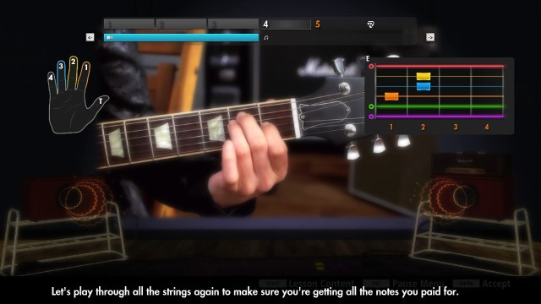
Rockband 2
vs
Rocksmith 2014

Slide 19
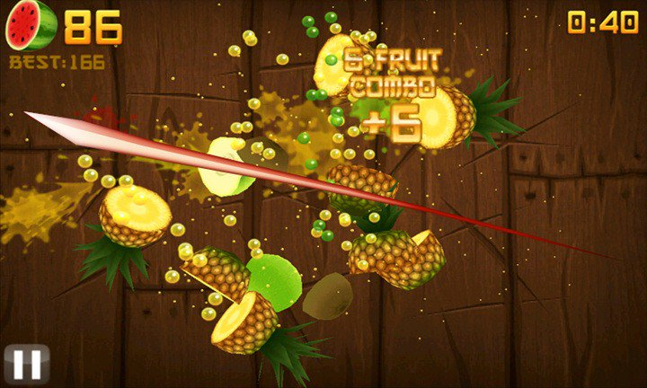
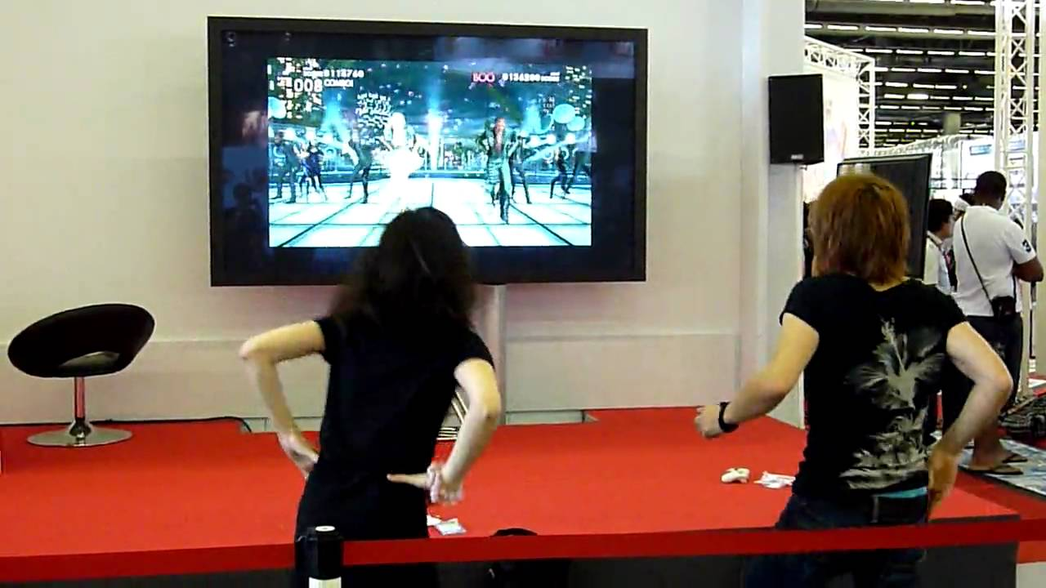

Slide 20
Subset of real action: “exergaming”
  Games emphasizing physical activity as control
  Ranges from actual exercise management to more obscure ideas
    Narrow def: games DESIGNED for exercise
    Broader def: games RESULTING in exercise
  Some claim health benefit; others point out the short interest span

Slide 21

Wii Fit vs Wii Sports

Slide 22
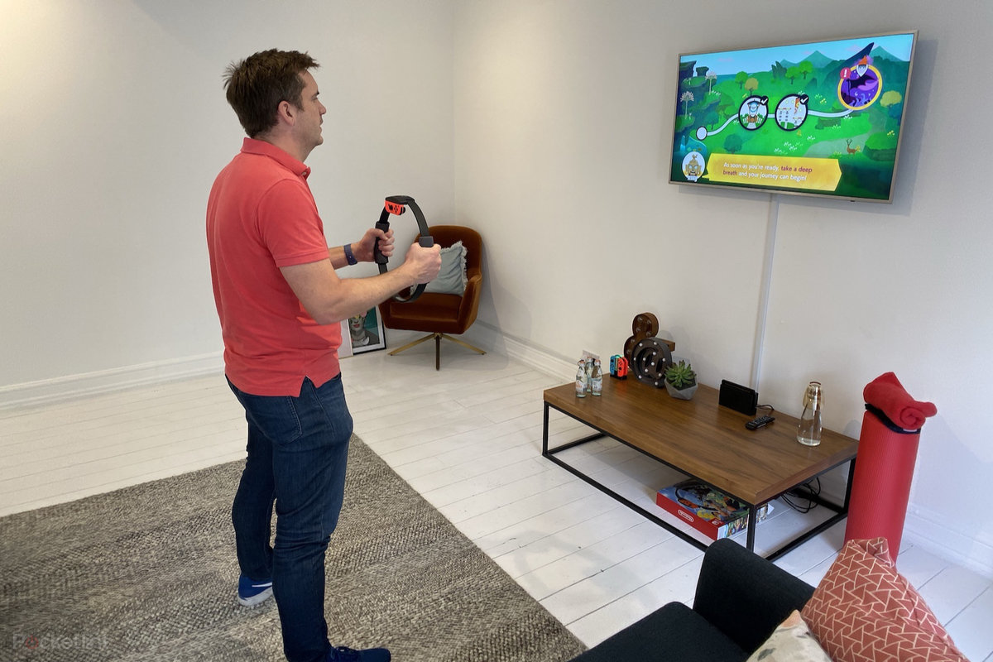
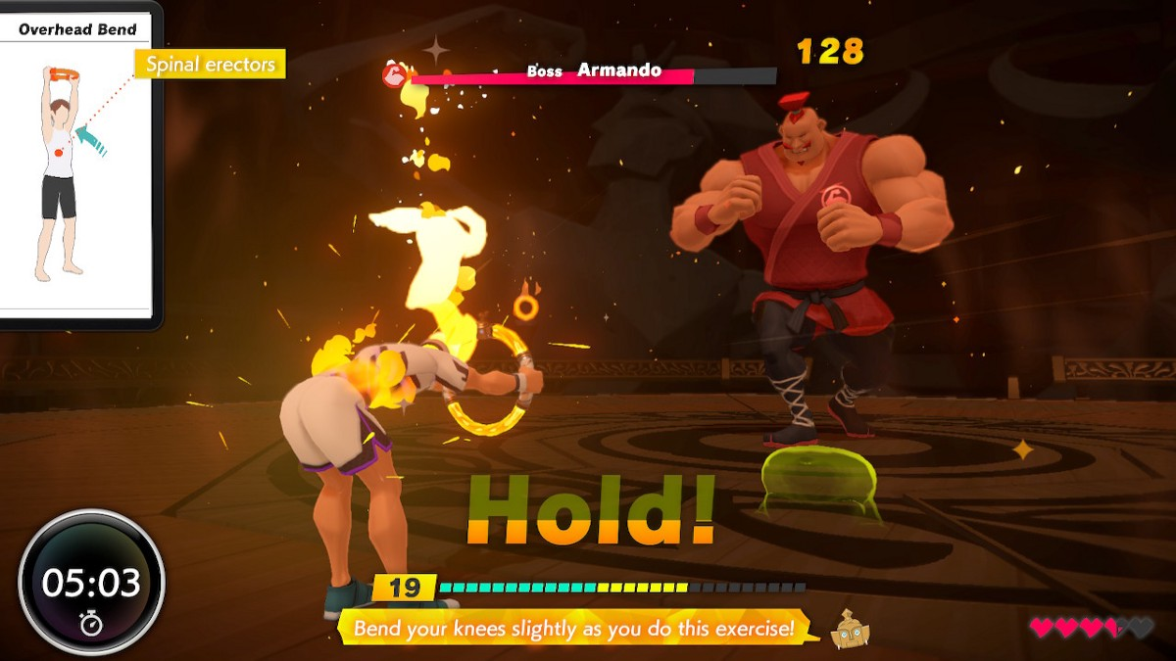
Getting the equation right: Ring Fit (2019)

Slide 23
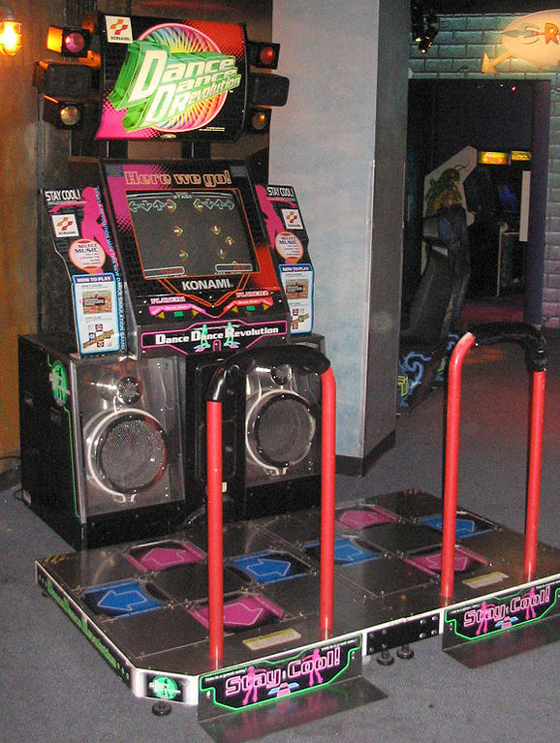
Long history in arcades (e.g., Dance Dance Revolution)
Entered living rooms with motion-controlled games
Wii Sports is highest selling game ever (82.79M worldwide as of Sep 2016)
  Included with Wii

Slide 24
Adaptive Input Interface
Origin: custom key layouts
Now: learning mechanism + accessibility
  https://www.xbox.com/en-US/accessories/controllers/xbox-adaptive-controller

Slide 25
Elements of Good Output Interface
Adequate diegetic sensory stimulus!
  e.g. vision and sound depicting the in-game world
  Visual style and sound design need to MATCH the narrative and game mechanics
    Important point in evaluating AESTHETICS
  POV decides what the player is.
  How MUCH to show, make heard
    Utilizing limited screen space in creative ways
    Good design: responsive to action and progress

Slide 26
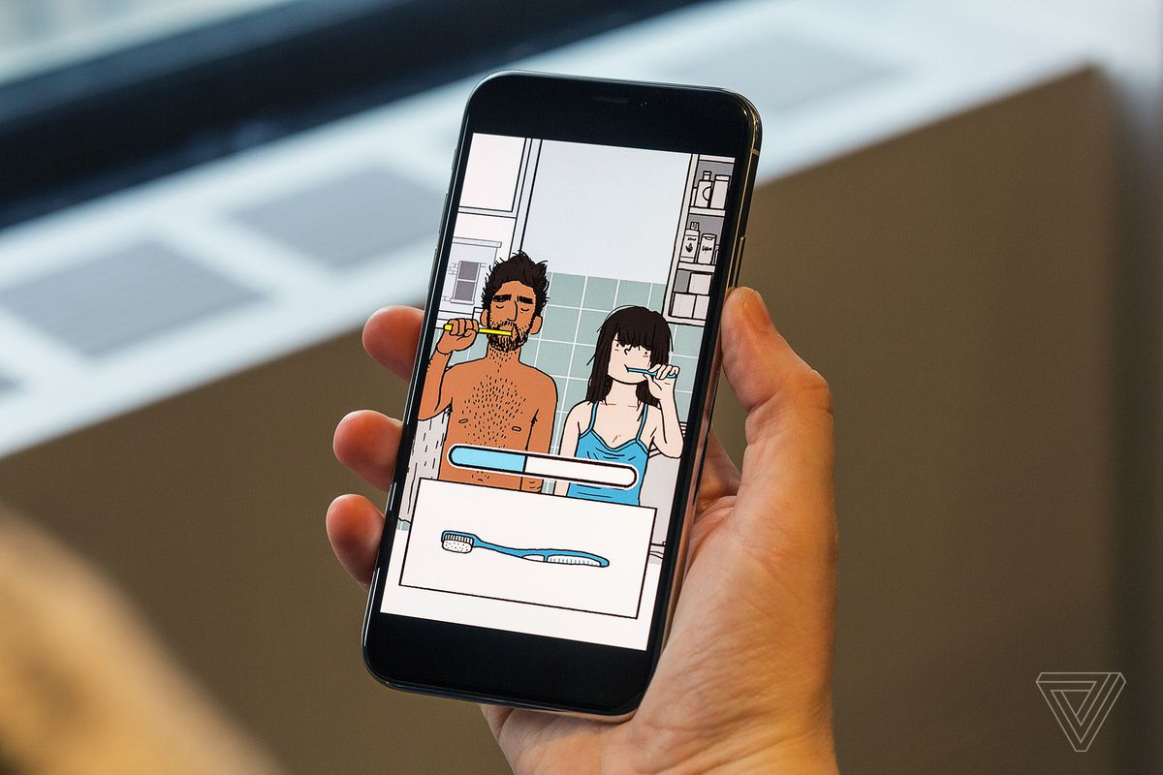
Case in point: Florence (2018, iOS)
  Progress shown through various modes, differing each chapter; closely reflecting the narrative itself.

Slide 27
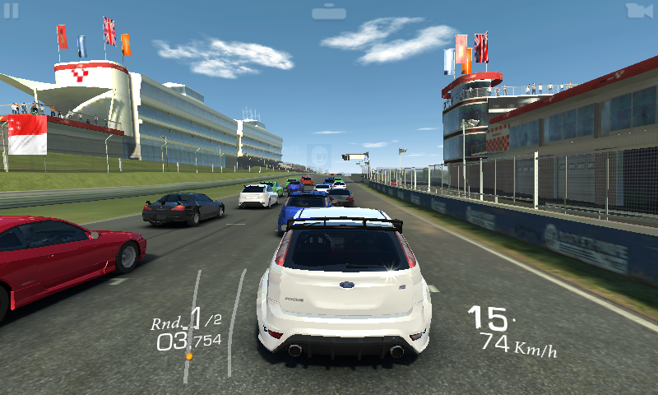
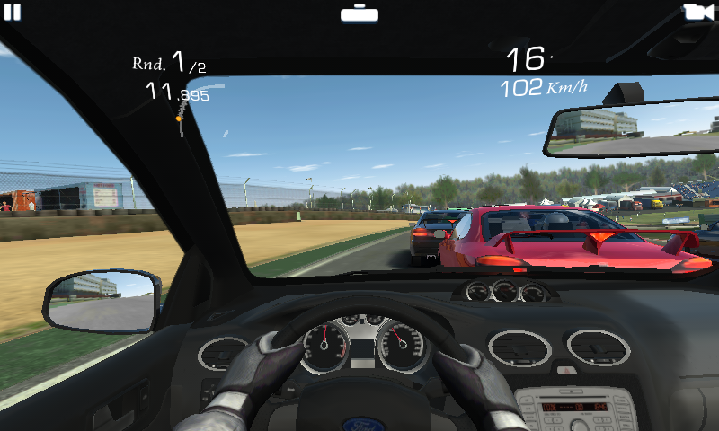
Real Racing 3 (2013)

Slide 28
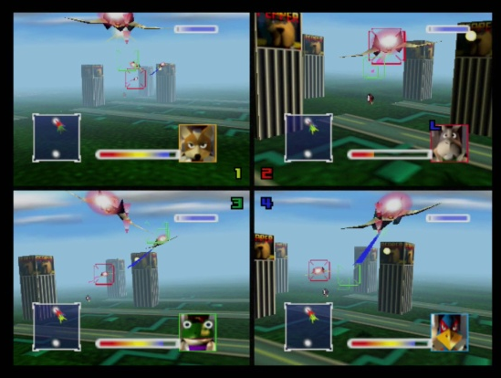
Starfox 64 (1997) Versus mode: split screen as unavoidable necessity

Slide 29
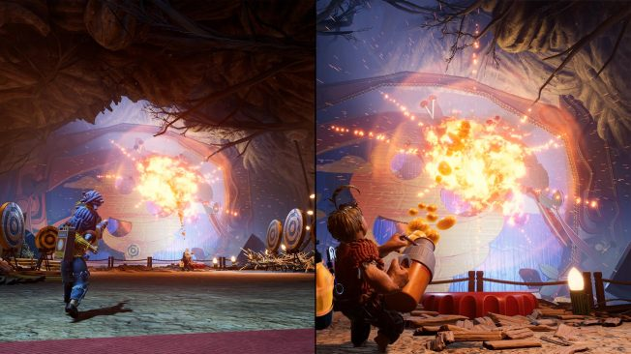
It Takes Two (2021): split screen as key element
  https://www.youtube.com/watch?v=joraCOo1n1c

Slide 30
Selection and presentation of information!
  Nobody likes cluttered dashboards.
    Save center of screen for the action
    Enable toggle
Typical elements:
  Progress: score, lv, etc
  Status: energy, location, etc
  Items: special skills to use
  Menu: activate non-routine actions
  …remember: sometimes, NOT knowing is fun.

Slide 31
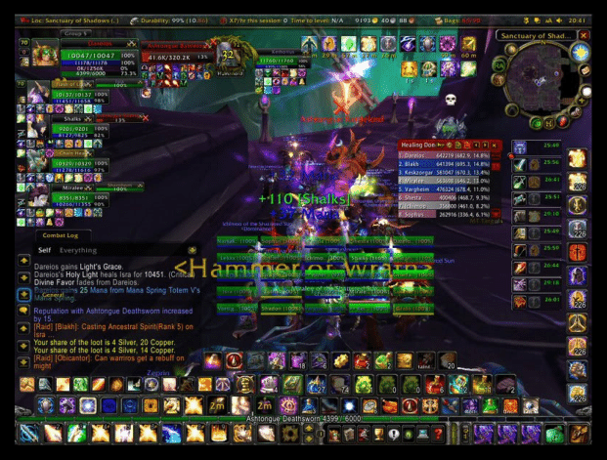
WoW with everything on (Turkay, 2011)

Slide 32
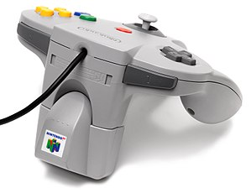
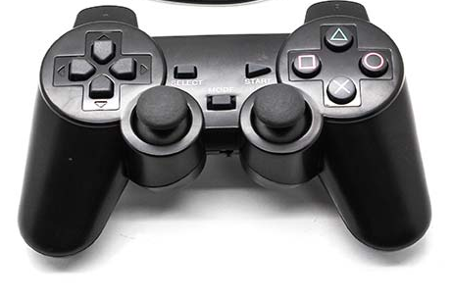
Force feedback!
  Tactile response to in-game situations
  Effective simulation of physical interaction
    Mainstream hit: Nintendo Rumble Pak (1997)
    Breakthrough redesign: Resident Evil Dualshock version (1998)
  Crucial element for more immersive gaming

Slide 33
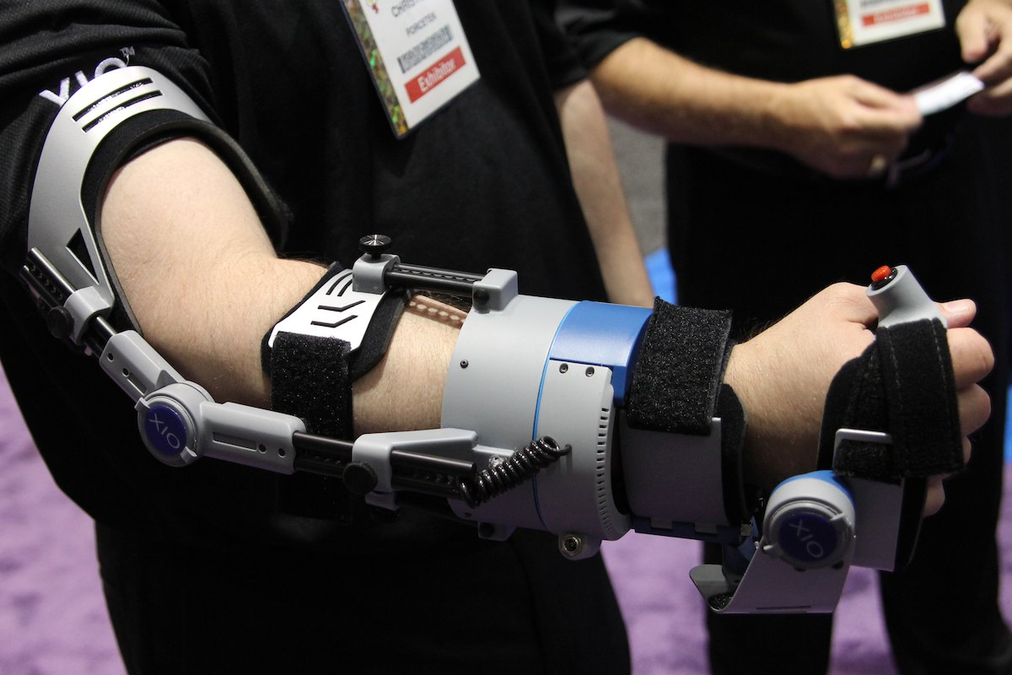
Forcetech XIO (2010): led to… nowhere

Slide 34
Immersive Environment
VR: Bringing your senses into the game reality
When does an artificial world feel real?
  Sensory information about the virtual space overshadows that of the physical
    Information relative to the expectations of the body
    Isolation of outside world
    The physiological valley between the physical and the virtual: motion sickness
  Current tech: 360 degree sight, spatial sound, limited touch through force feedback

Slide 35
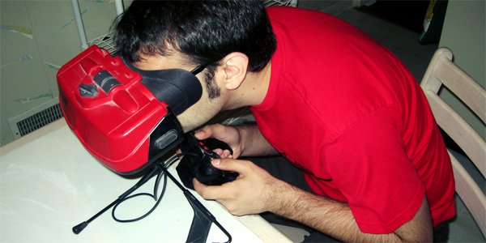
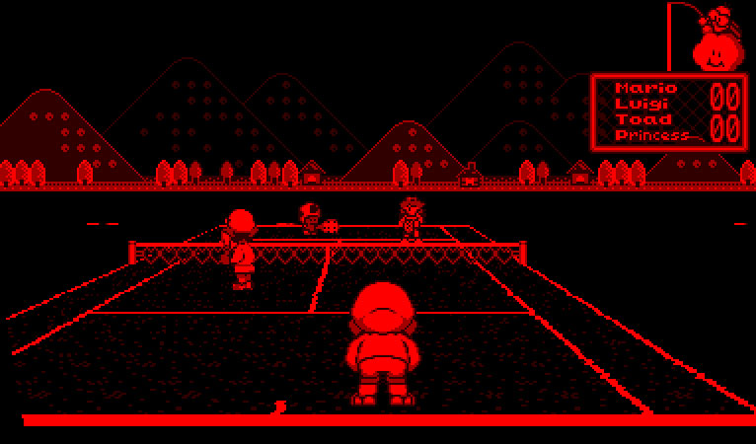
https://www.tested.com/tech/gaming/723-what-3d-has-to-learn-from-the-virtual-boy-15-years-later/
Nintendo Virtualboy (1995)
  Failed to take off (only 22 games released ever)
  Lesson: 3D by itself doesn’t do the job

Slide 36
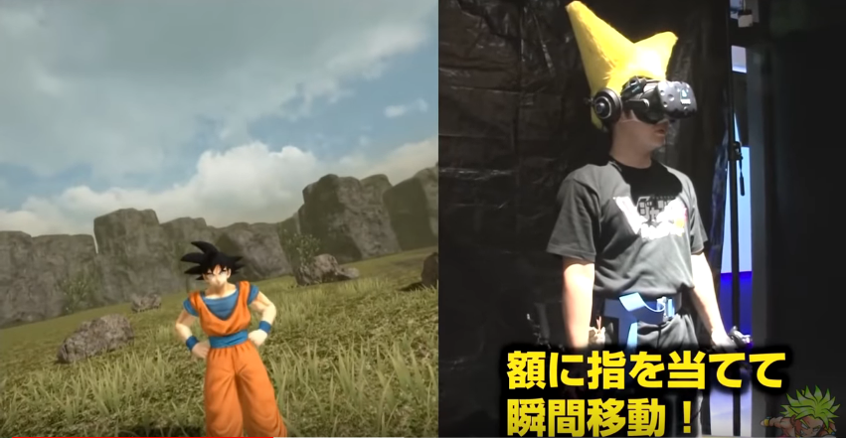
Case: Dragonball VR (2017, HTC Vive + accessories)
  https://youtu.be/TB4dQwyv4Kg?t=51
  Shooting Chi blasts with correct poses

Slide 37
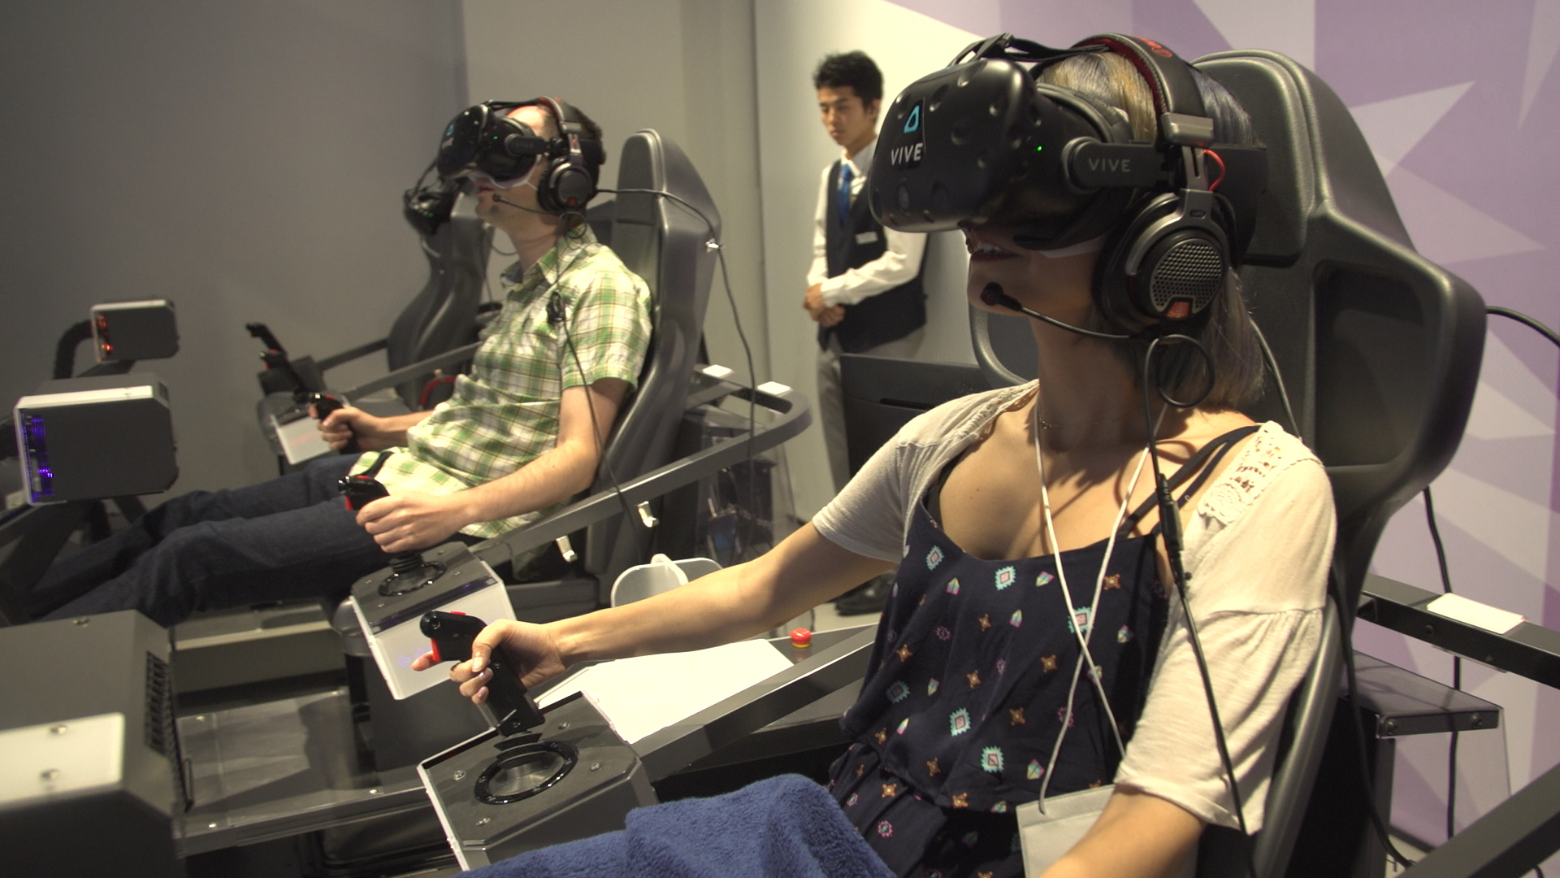
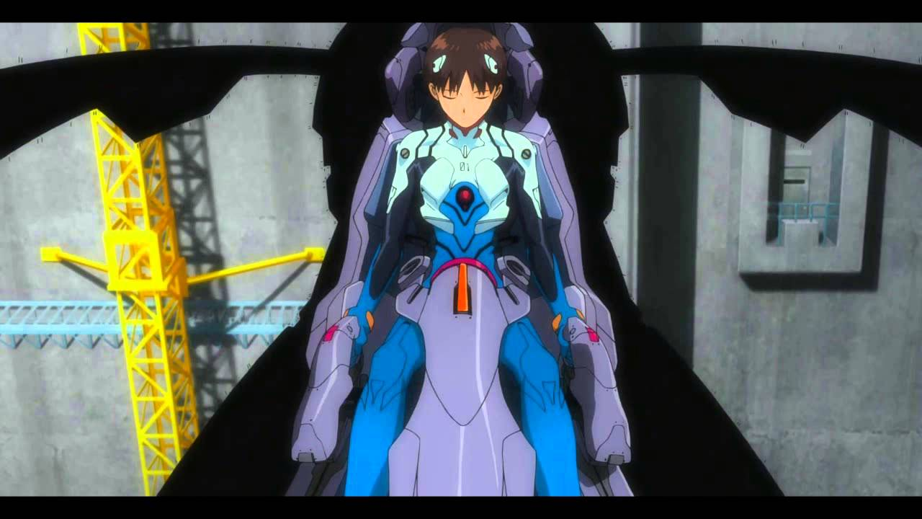
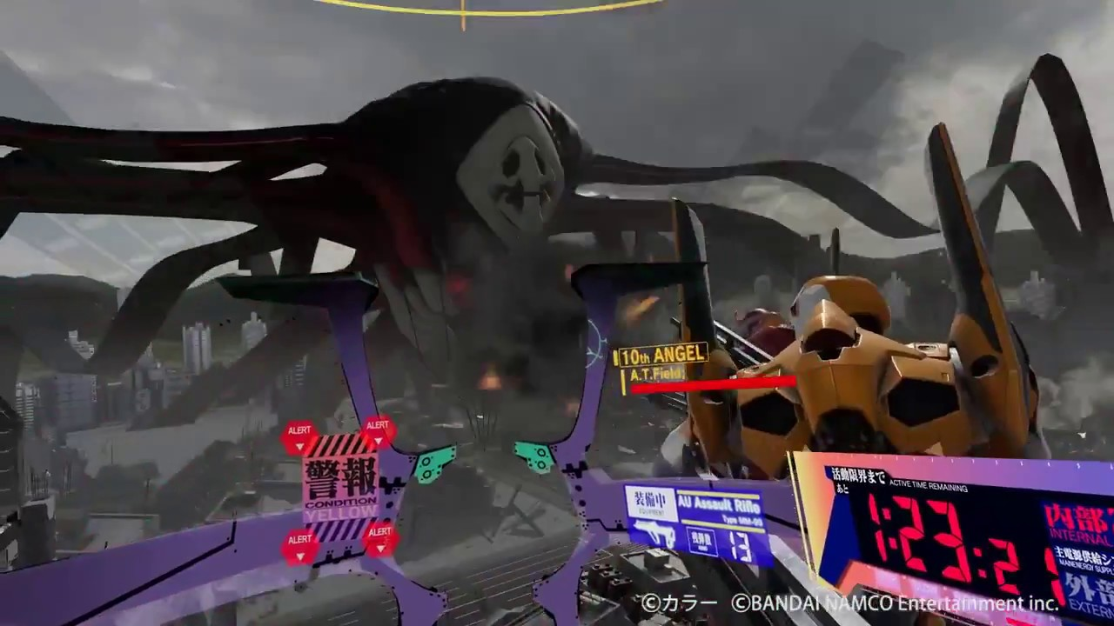

Case: Evangelion: Throne of Souls (2017, HTC Vive + acc)
  https://www.youtube.com/watch?v=FVahCy5NGZ8
  Piloting a giant robot
You
The anime

Slide 38
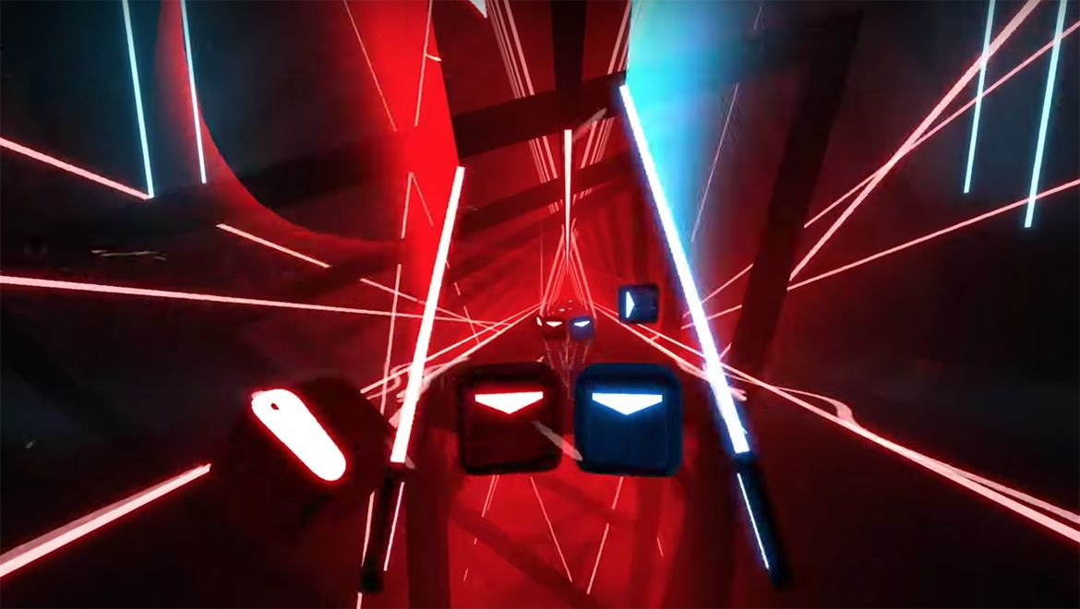
Case: Beat Saber (2018, Oculus)
  World can be abstract as long as it is spatially coherent

Slide 39
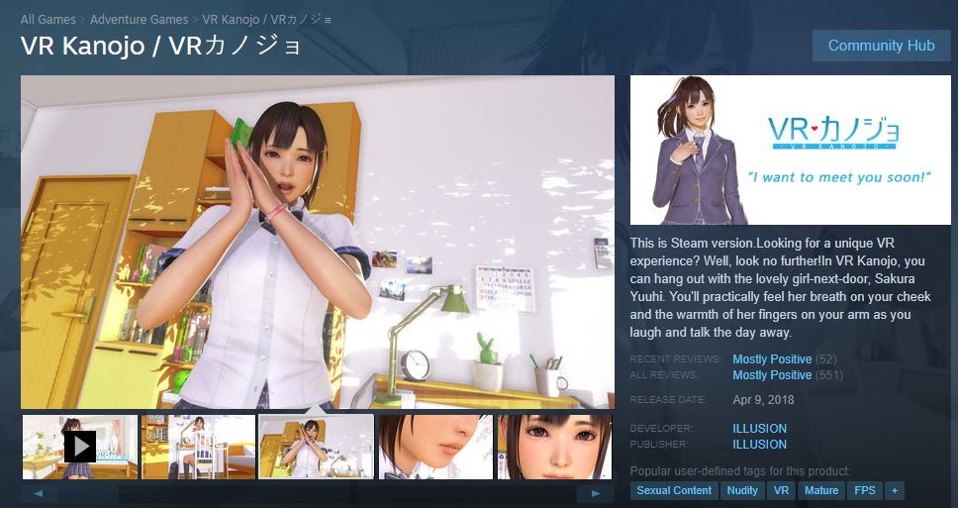
And of course…

Slide 40
AR: Planting the game into your physical reality
  Mixes artificial sensory information on top of physical ones
    Requires constant scanning of physical environment.
    Semi-transparent screen or camera synthesis
  If the mix is done right, results in much stronger sense of spatial reality than VR
    Because our sense of reality is rooted in the physical.
  Strength in gaming: real space
  Weakness: real space

Slide 41
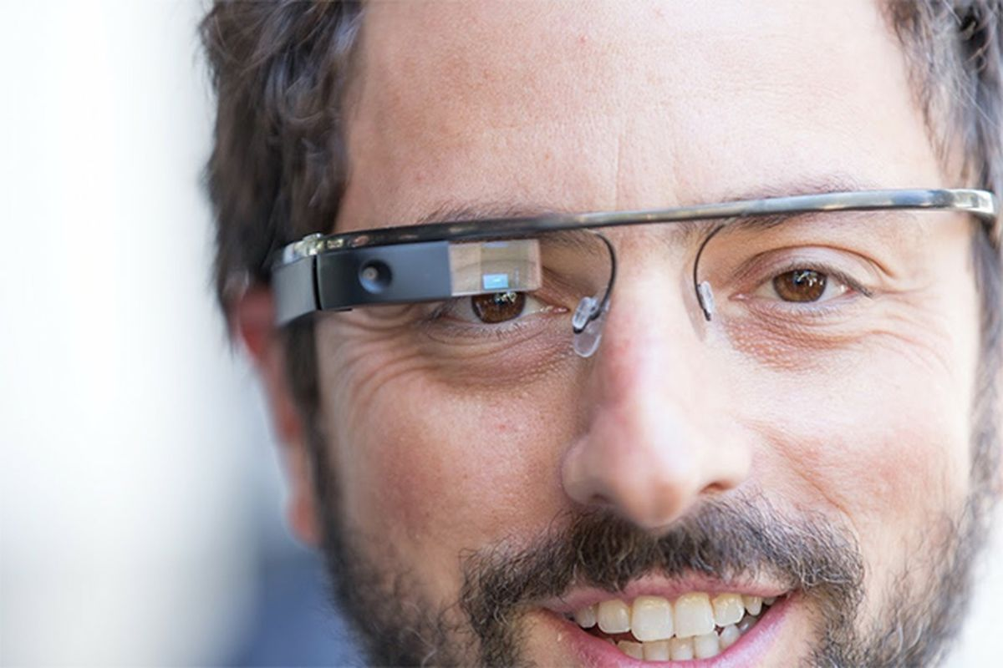
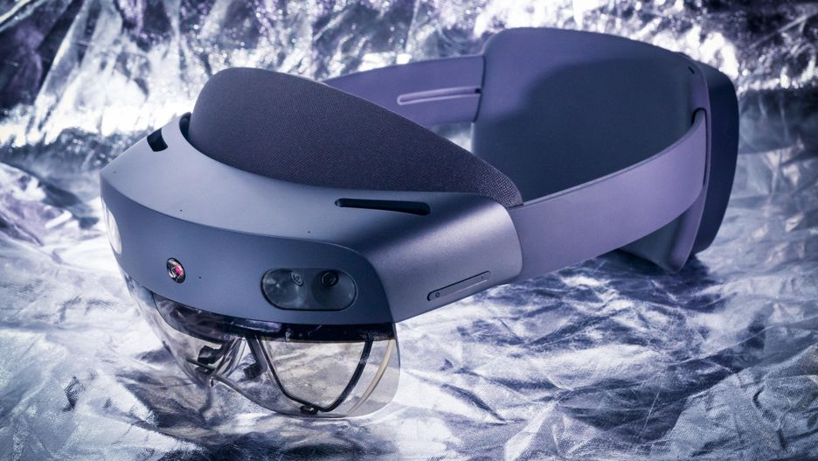
Google Glass (doomed)
MS Hololens2 (2019)

Slide 42
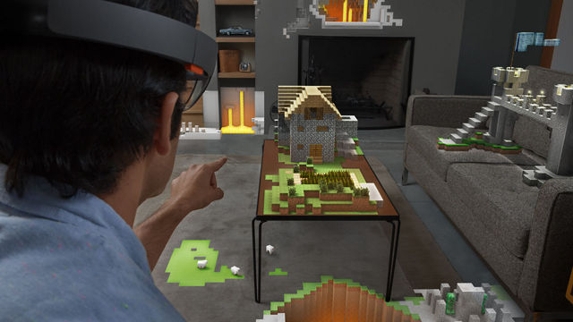
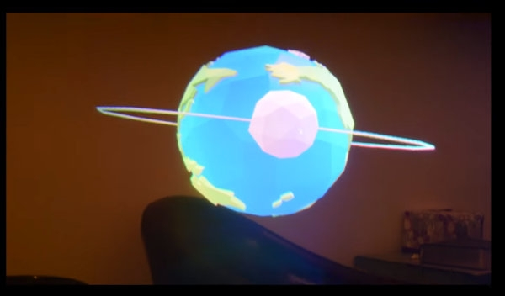
Concept (Minecraft AR demo at E3, 2015)
Actual view

Slide 43

Pokemon Go (2016)
  Started as Google April Fool’s prank
  Huge hit due to AR elements, despite subpar play value
  By 2018: over 800 million downloads / 147 million monthly active users (2018) / $3 billion revenue

Slide 44

(When realities collide: )
https://www.washingtonpost.com/news/tripping/wp/2017/11/29/traffic-accidents-increased-after-pokemon-go-came-out-researchers-say/

Slide 45
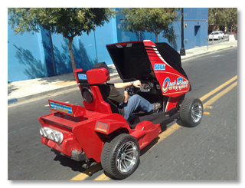
Open for more insane experiments
  Garnet Hertz’s Outrun (2011)
    https://youtu.be/zd-t7WoshS4
    Transforming physical space into a game screen, to actually drive in physical space

Slide 46
Other attempts to connect the two realities
  Toys-to-game
    Tangible character toys enabling game play with those
    E.g. Skylanders, Lego Dimension, Disney Infinity
    Glorified in-app purchases?
  Fantasy Sports
    Virtual teams made from actual sports stats
    Virtual league progressing based on actual league progresses
    An actual industry ($2.6 bn in 2015)

Slide 47

GotW: Cat Magic Academy (2016)
https://www.google.com/doodles/halloween-2016
  Production notes included
Released as a Halloween Google Doodle
  Full-story mini game, w/ tutorial level
Think input interface
  How does the player learn how to control actions?
  How do the actions match the in-game world? (e.g. style, narrative, etc)
  How do challenges-skills evolve?

