Slide 1
“New” Media and Civic Engagement
COMM 110 Fall 22 / Week7 Nakho Kim

Slide 2
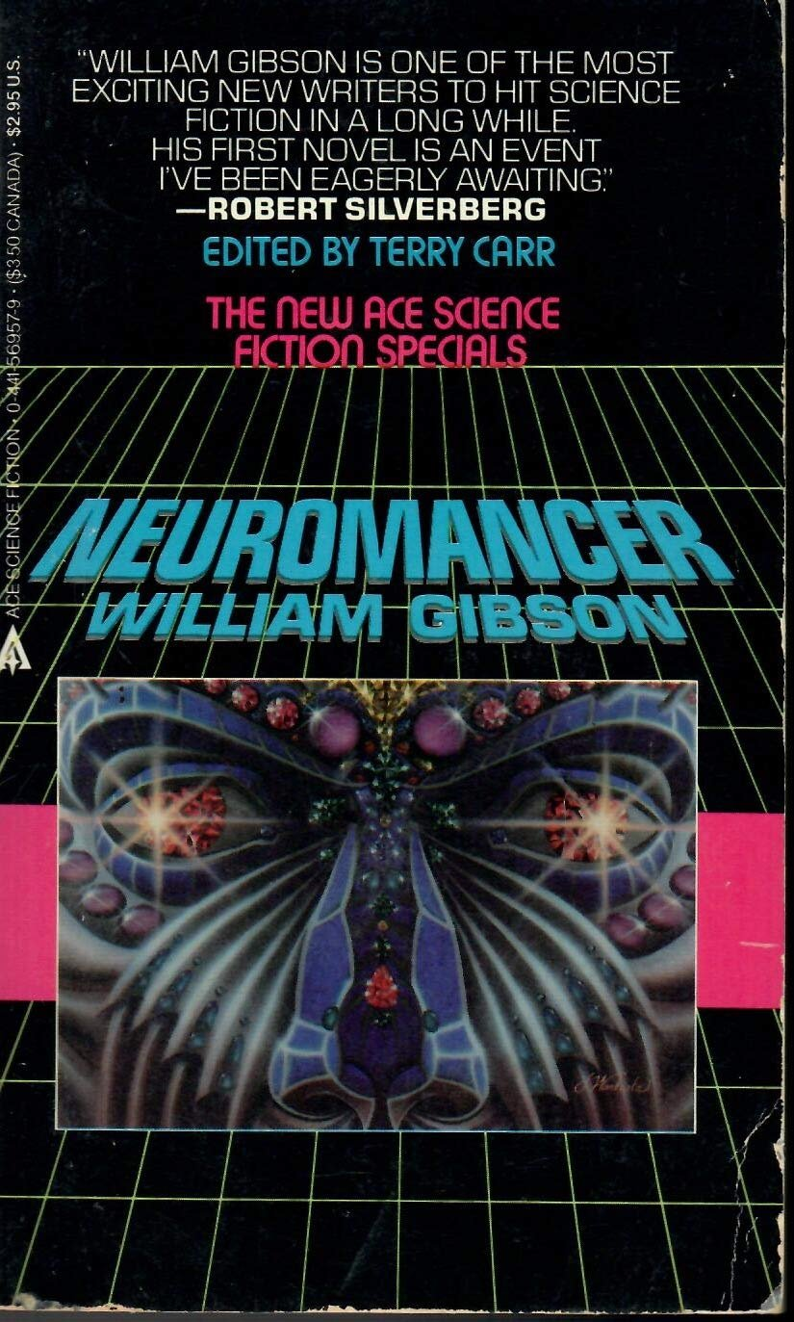
"The future is already here - it's just not very evenly distributed.“
-- William Gibson* (1993)
* The guy who made cyberspace an actual word.

Slide 3
New media changes how we live our lives, interact with one another.
But not uniformly.

Slide 4
Things to ponder:
How to ask questions on the “new” in new media
Using new media on old civic issues
New civic issues from new media use

Slide 5
“I've come up with a set of rules that describe our reactions to technologies:
1. Anything that is in the world when you’re born is normal and ordinary and is just a natural part of the way the world works.
2. Anything that's invented between when you’re fifteen and thirty-five is new and exciting and revolutionary and you can probably get a career in it.
3. Anything invented after you're thirty-five is against the natural order of things.”
Douglas Adams, The Salmon of Thought

Slide 6
Premise:
All media forms were “new” once
All new media become old
All media are used in social context of its time
Economic / Technical / Cultural / etc

Slide 8
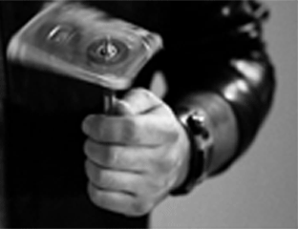

Slide 9
“New” Media Over Time
Print, Phones, Radio, TV
Online networks
Cultures get attached to / develop from specific media technologies
But directions can vary

Slide 10
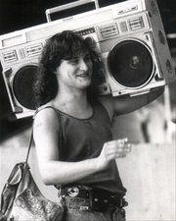
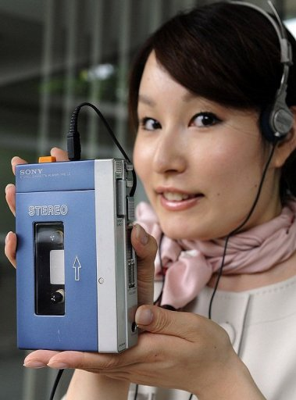
Example: Boombox and Walkman
Based on same technology (the cassette tape), redefined social spaces based on the aural experience
..in quite different ways!

Slide 11
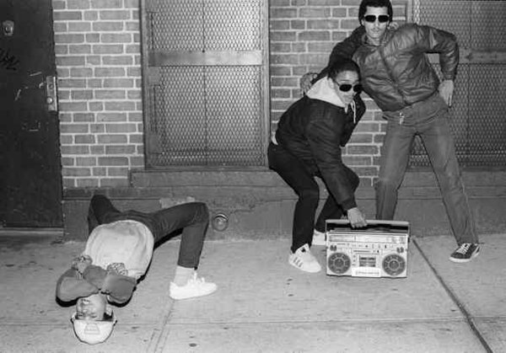
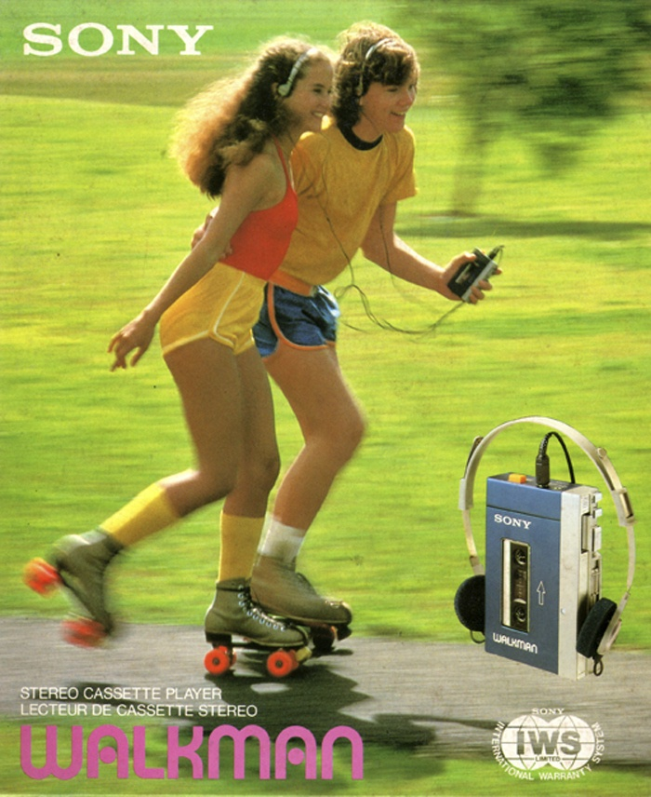
(Source: philly.com)

Slide 12
BB: the alley as a social stage yet personal; deep bass soundscape
WM: The (inter)personal intimacy of the ‘mixtape’; shrill treble soundscape
Media tech affects communication, thus interaction spaces.
Another example: “Atari shock”
The living room as peer communal space, competing with shopping arcades

Slide 13
More recent examples to ponder
Is the internet of 00s same as the one we have now?
What matters is not merely the technology, but technology in context to our lived experiences.

Slide 14
As such, we need to build critical awareness on how new media adoption changes our understanding of society
And by extension, what we want to do with that society.
…hence, it becomes a media and democracy issue.
Some chilling reflections on the larger idea
Business or Pleasure, by Chris Ware (2017) http://www.newyorker.com/?p=3512958
Sabrina, by Nick Drnaso (2018).

Slide 15
New Media and Civic Issues
Participating in existing civic issues by using newer media
New civic issues BROUGHT FORTH by the use of new media

Slide 16
Media Impact on Existing Civic Issues
Newer media affords expanded / newer forms of political PRESSURE
Communicative pressure matters, because…

Slide 17
Civic Participation in a
Representative Democracy:
A Conceptual Model
System change
End goal
Policy change
Project goal
Media/Communication
plays crucial role in many stages
Enforce behavior
Replace agent
Action
objective
Pressure agent
Vote for challenger
& pressure peer voters
Organized pressure
Election campaign
Power demonstration
(protests / donation)
Assemblies
Power demonstration
Legal action
Communication
-based action
Visits
(real & mediated)
Assemblies
Peer visits
Threat to go B
A
Y
Is the next election far off?
N
Modes of action
Reflexive loop
N
Action
contemplation
Spread the word
Is the official
generally okay?
Be present
Y
Donate
Volunteer work
Issue deliberation
Become an officer
Discuss
views
Share
Information
Deliberation
Nakho Kim 2014
(But heavily inspired by ppl like Przeworski, Hirschmann,)

Slide 18
...in short*:
Communication IS the core of political action.
At least, in a democracy.
Then,
What kind of functions should (or do) media tools fulfill, to strengthen civic engagement?
* No, you don’t need to memorize the full diagram.

Slide 19
Media Functions for Civic Engagement
Participation in general: rational choice
“Calculus of Voting” (Riker & Ordeshook, 1968)
R = PB + D – C
P: perceived probability of effect, B:benefit, D: feeling of duty, C: cost.
Translated: Key conditions for engagement
Identity: otherwise, not my business
Efficacy: otherwise, why bother?
Convenience: otherwise, too much of a chore

Slide 20
Meanwhile, communication CAN provide
Information: classic role
Discussion: mediated multi-directional communication
Reward system: social recognition, mediation to political process, etc.

Slide 21
Combining the matrix
A systematic approach to which kinds of civic media projects to develop, to bolster specific cells in the table.
Some examples:
 | Information | Discussion | Reward system
Identity | news connecting micro-macro scales | sharing common community interests | Bragging rights
Efficacy | “what-can-be-done” news | collaboration spaces | Bragging rights
Convenience | how-to info | advocacy, consensus tracker | petition tools, organizer
Nakho Kim 2014
Notes:
Note: remember your final essay will be about identifying a media & democracy problem and suggest a solution. This approach WILL come in handy.

Slide 22
Then, what about actions for radical change?
Do social media tools make big changes in civic issues easier?
A keynote on the Gezi park protests in Turkey (Watch the full talk later on your own: )
https://www.ted.com/talks/zeynep_tufekci_how_the_internet_has_made_social_change_easy_to_organize_hard_to_win?language=en

Slide 23
5-element model of radical political change:
- Key elements from social movement research (motivation, mobilization, network)
- Real-life primer (opportunity) and classic philosophies on revolutions (non-violence)
Motivation
(i.e. discontent)
Regime needs to be unpopular to general public.
If insufficient: spiral of silence arises.
E.g. highly divided but normally functioning societies
Mobilization
(based on efficacy)
Regime's power must appear weakened.
If insufficient: collective action problem arises.
E.g. North Korea under heavy gov surveillance
Network
(for self-organization)
People need to organize themselves in the process.
If insufficient: momentum doesn’t last.
E.g. London riots of 2012
Opportunity
(for action)
Tipping point case and escalations are required.
If missing: action doesn’t erupt.
E.g. Authoritarian governments at stable times
Non-violence
(to prevail)
Regime must be rendered incapable of using brute force.
If missing: violent suppression.
E.g. the civil war in Syria as part of the ”Arab Spring”
Nakho Kim 2014

Slide 24
Social Media: pros and cons by each element
Motivation
-Good for: sharing info & emotions. Alternative source.
Downside: can provide false catharsis.
Regime's counter-use: propaganda.
-Good for: sharing info & resolution.
-Downside: can also spread helplessness.
-Counter-use: propaganda.
-Good for: sharing info, coordinate meetings, collective decisions…
-Downside: scaling problem
-Counter-use: can be utilized to hunt down participants
-Good for: spreading the word. Contributing to escalation.
-Downside: misinformation.
-Counter-use: intentional production of misinformation.
-Good for: Social media cannot do much about this.
Downside: underestimating risks.
Counter-use: making threats of violent suppression.
Mobilization
MOST useful
Network
Opportunity
LEAST useful
Non-violence

Slide 25
Social media does NOT
…cause, or even necessarily help radical political change.
Social media does
…bring about changes in the existing communication
- changes news flows
- provides better tools to connect among people, organizations, etc
Downsides and counter-uses should be carefully controlled and countered.

Slide 26
Two sides of Convenience
Easier participation vs shallower involvement
“Slacktivism”
Minimal cost and good-enough satisfaction to the participant
But not effective in doing actual labor- and time intensive complex works towards change

Slide 27
Also, a wider reach does not equal actual solutions
…b/c actual situations tend to be more complex
Requiring prolonged, in-depth approach
Example: KONY 2012
https://www.youtube.com/watch?v=Y4MnpzG5Sqc

Slide 28
Media as Augmentation to Action
Using new media tools to strengthen existing social action methods
Case in point: Wisconsin Labor Protest 2011
Context: state gov removed collective bargaining rights of public unions
Forms of opposition:
Massive protest, led by teachers, police, firefighters, etc
Legislative challenge in the state assembly
Gubernatorial recall effort
Media tools mainly used for supporting those efforts

Slide 29
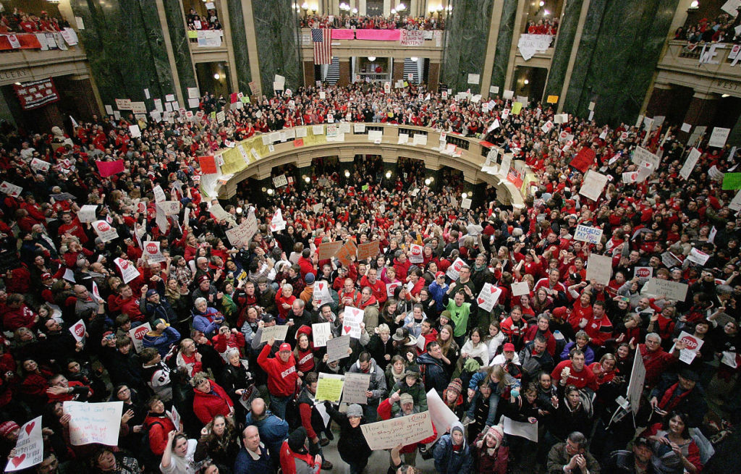
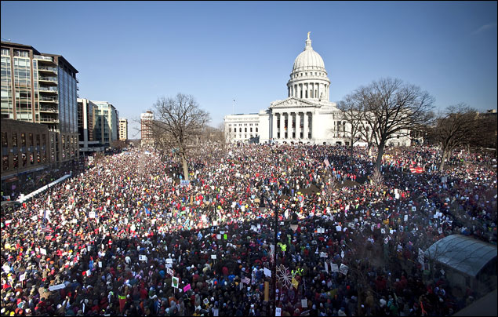
The sheer logistics
© WiStJournal

Slide 30
“New” media tools
Managing sit-ins through Twitter, FB, etc
Mobilizing with mailing lists, online videos, etc
Archiving the whole process
Pizza
“Old” methods
Massive street march
Networking local retailers
Gub recall campaign, door-to-door
Phone call to legislation
Labor strike
…Even so, mixed results

Slide 31
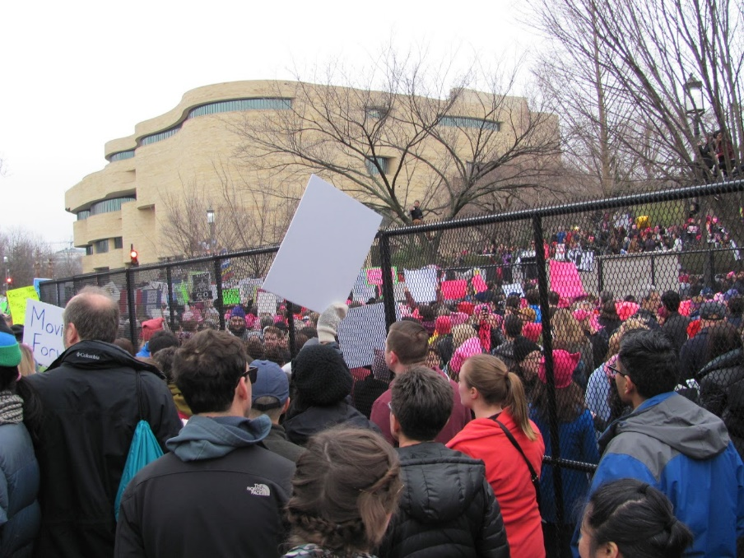
More recent: 2017 Women’s March
In protest to the anti-women’s rights policy positions and rhetoric of the newly elected president Trump.
Rapid large-scale organizing
Elected: Nov 9. 2016. Inauguration: Jan 20, 2017.
Worldwide protests: Jan 21, 2017.
470k in DC alone; 5.24 mil in the US; 7 mil globally.
Mobilizing diverse existing organizations, as well as intensive grassroot campaigning going viral.

Slide 32
New(ish) Issues from Use of New Media: Information Rights
Due to the technological affordances
Scale and sophistication of connection and duplication
Privacy
Social Networking: nudging us to invade our own privacy (refer: Preston article)
Business goals vs privacy rights
Free service! (e.g. Google, FB, etc)
More data = more chances of profit
The right to speak anonymously
The right to be forgotten

Slide 33
Surveillance
NSA scandal
The right not to be spied on (“chilling effect”)
Copyright
The right to stand on the shoulders of giants
The right to let my work to be shared
Creative Commons

Slide 34
New(ish) Issues: Civility
Interpersonal problems, vastly amplified
Proportionality problem, intended or not
“Revenge porn”
Hate speech
(Cyber)bullying
Public shaming in massive scale: the Justine Sacco case http://www.nytimes.com/2015/02/15/magazine/how-one-stupid-tweet-ruined-justine-saccos-life.html
Combined with gender politics: “Gamergate”

Slide 35
New(ish) Issues: Social Links
Loss of community?
A long-lamented trend: “Bowling Alone” (Putnam)
Personalization, new ways of networking
Less alignment between physical community and community of interest
But then again, on and offline also augment each other (“Networked”, Wellman & Rainie)

Slide 36
Internet “Bill of Rights”
Recent attempt: https://www.nytimes.com/2018/10/04/opinion/ro-khanna-internet-bill-of-rights.html
10 rights for data control, access and data use

Slide 38
Transition into Phase II: ISSUES AND STAKES
Goal:
To put all those fundamental mechanisms and theoretical ideas into practical use.
Issues:
Because there are so many issues that can be resolved (or at least attempted to be) only through collective consensus and building a robust system around it.
Stakes:
Because in a non-Borg society, an issue has different impacts on different demographics.
IOW, how can we build an empathy-coalition that WILL lead to a consensus?

Slide 39
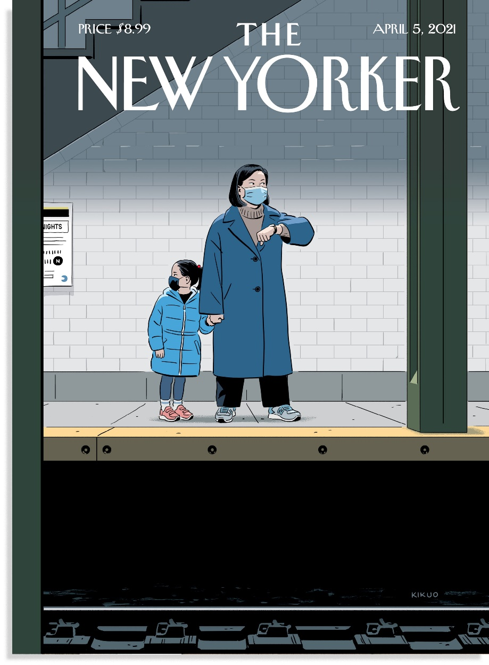
Case: Chinavirus, Kung Flu rhetoric
Strategic rhetoric of one ideology camp:
“Humorous” language
Deflecting COVID-frustration toward outside
Just words, no harm
…unless you are an Asian.
https://www.aapihatecrimes.org/facts

Slide 40
In all, understanding (or at least being aware of) differences in stakes among different demographics is the first step toward solutions;
And the use of MEDIA in that process will be quintessential.
Representation, discussion, data, activism… you name it

