Slide 1
Digital Politics: Online Public Sphere
COMM / IST 234: Digital Cultures W#7
Nakho Kim
Communication
Penn State HBG

Slide 2
How Digital Changes Politics
Remember the digital traits?
Highly processed information
Wider, looser, interest-based networking
Huge amount of information on hand
Higher interactivity enabled
Politics
Activities of power dynamics, to make decisions for a group (‘governance’).
What will change, if certain members of that group acquire those digital capabilities?

Slide 3
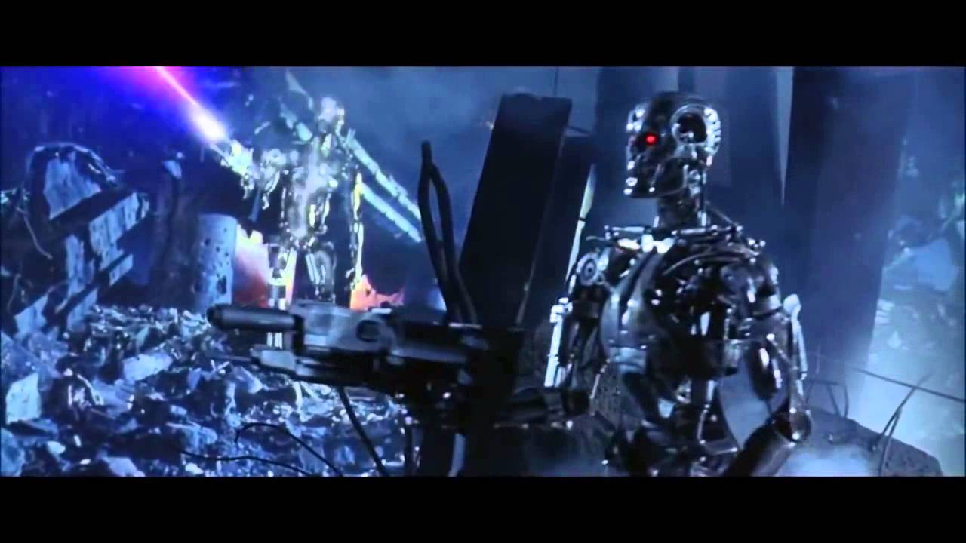
Terminator: Skynet, the AI network decides that humans are the problem
…But on a more realistic note, let’s narrow down on democracy.

Slide 4
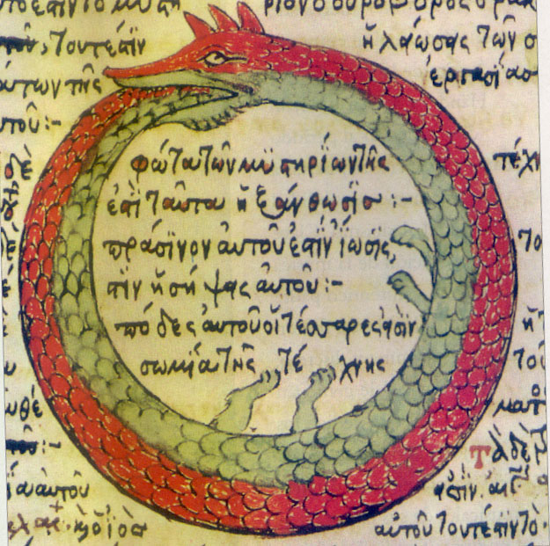
Democracy
A social operating system based on the idea of self-rule, by making people rule people.
With mechanisms to reflect the will of the people.
Most notably, elections for representatives.
Which makes it by definition legitimate.
Hence, every modern nation proclaims to be one.
Yes, even North Korea.

Slide 5
But a well-running democracy REQUIRES a vast majority of its people to…
Stay well-informed on public issues of urgency,
Have networks with other people to strengthen causes,
Take various actions on decision-making.
(…otherwise, it is just an inefficient, dysfunctional mess of a system that gets abused all the time by powerholders, resulting in problematic outcomes.)
Fascism, church-and-state recombined, race-nationalism, diminishing public good, etc from historical evidence.

Slide 6
Early Hopes of eDemocracy
Digital media as tools to make existing processes easier.
Access to public data, instead of public requests and libraries
Online petitions, instead of paper petitions
Online voting, instead of physical places and lines

Slide 7
As networked digital communication matured, other more complex elements came within sight:
1. discussion. 2. networked action.

Slide 8
The Ideal Discussion: Public Sphere
J. Habermas: contemporary conceptualization
In short: the ideal open social forum
Lifeworld, private and individual experiences
The “Public” realm:
discussing public issues freely to form opinions
Communicative action, governed by rationality
Nothing else matters here (e.g. money, status, race…)
The bridge between lifeworld and system
Ideas based on life experience, feeding into upgrading system
System, institutionalized social procedures

Slide 9
Can digital “spaces” become such public spheres?
Hopes: the potentials are there.
Open, unrestricted identity, communicative action, data for rationality, etc

Slide 10
Reality: turns out to be… complicated.
Communication does not happen in a conceptual vacuum.
Communication happens only in sub-groups.
Any environment can be exploited by all.
Why be rational, when I can just win?
Private platforms follow private interests.

Slide 11
Not in a Vacuum
Communication privileges messengers that are more adept at the platform.
E.g. The tech-savvy.
E.g. The optimizing ones.
E.g. The rule setters.
Which often reflects existing power imbalances.
Case: English language Wikipedia editors
89% White, 85% Male (as of 2021)

Slide 12
Only in Sub-groups
No one aims to talk with the entirety of the network.
Because the network is essentially global.
But the sub-networks can be homogeneous.
Due to the flexible customizability of networks.
And we want… the comfort of self confirmation.
Concerns about fragmented public spheres
Silos, echo chambers, filter bubbles, etc

Slide 13
Any Environment Can be Exploited
Especially digital ones.
Because elements are highly processable.
Case: bots
Some passing as humans
Some simply being good at massive repetitive tasks
Case: algorithm exploitation
Search engine optimization, trend hack, etc
Case: exploitative algorithm
Invasive recommendations

Slide 14
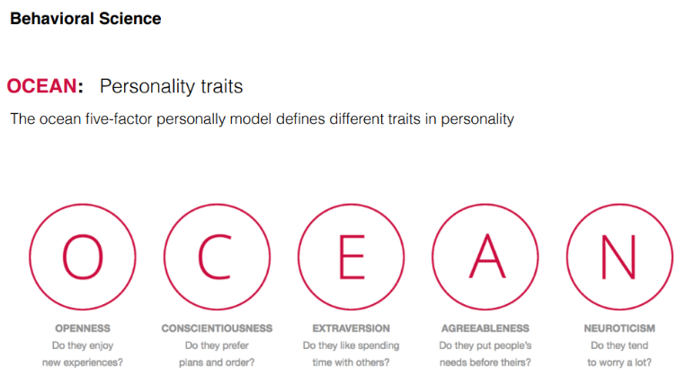
Case: Cambridge Analytica Scandal
Under the guise of a personality test…
harvested personality data from FB users, including personal networks (in total, 87 mil)…
and used it to provide microtargeting services the 2016 Trump and Cruz campaigns.
E.g. targeted ad exposure, false information, etc
Algorithm hack at its most subtle
No, micro-targeting in itself is not unethical.
It’s the deceptive collection and use of data.
Aftermath?

Slide 15
Owning over Everything Else
Open-ended nature of online networks
Generally, low consensus on norms and rules*
Too many n00bs or trolls at all times.
Lack of project goal, making everything into an endurance test.
Affectionate polarization
Amassing a large cluster based on strong affection turns out to be more effective at setting the dominant climate than… logic.
Facts are for wussies
Arguments based on a strong feeling of confirmation are easier to make and more effective than… checking facts.

Slide 16
* The paradox of free speech
The original goal of having free speech, i.e. letting the best ideas for our society prevail by letting all ideas compete freely, can only work if it is well moderated.
Moderation includes setting various norms and enforcing them, including:
Constantly presenting common goals and
Reiterating boundaries of unacceptable ideas based on prior rejection.

Slide 17
Limits of Private Platforms
Building a public sphere on private platforms
Only as far as it does help the company gain profit.
Case: the non-profit trait of the invention of the internet
Case: Twitter’s Elon Musk sale fiasco

Slide 18
Networked Action
Early ideas of internet politics
(e.g. Barlow and many other tech-determinists)
The internet will transform politics through globally networked, decentralized communication
Unfettered information disseminated freely
Also, new freedoms of speech and association will be enabled.
Democratization of decision-making power.
Because… the internet is designed like that.

Slide 19
Context: Changes in Political Environment
Politics in the information society
Economy operating in the space of flows, less bound by space of places
Bypassing areas (places, issues) that are less attractive for efficiency
i.e. Globalization and neoliberalism became the standard.

Slide 20
Shifts in political interest (Chadwick, 2006)
Decline in voter turnout, decline in mainstream party membership, trend toward single-issue politics, catch-all parties instead of coherent ideologies, mediatization of politics, commercialized party funding…
New Social Movements
More flexible coalitions and groups around single issues, identity-based rights, etc.
Focus on lifestyle, cultural, or identity issues rather than economic ideologies. (at least on the surface)

Slide 21
…As such, we thought NSMs work great with the digital.
Flexible and scalable networking
Issues that are less local-bound
More focus on awareness than an action plan
Reality: turns out to be… complicated.

Slide 22
Information Politics
Can mean actually two things:
Mobilization for political aims, as afforded by information (technology)
Facebook-mediated “Arab Spring”! Twitter politicians! K-pop stans sabotaging Trump rallies!
Shifts in power dynamics, as a consequence of the information (technology) gap
Case in point: global inequality based on access to IT

Slide 23
Networked Motivation: Visibility
Get the word out that your cause exists.
Earliest example: the Zapatista movement in rural Mexico (mid-90s).
Online manifestos, interviews, and images, not having a chance to be covered in its contemporary mainstream mass media.
Digital network as the alternative media channel.
Initial step for many “grass-root” movements
Now: oversaturation?

Slide 24
Networked Mobilization
Getting more people to take action together.
Core component of movements in a democracy.
Digital tools enabling:
Wide recruitment pool
Low involvement action
Virality
When it works:
Case: ALS Ice Bucket Challenge
When it doesn’t:
“slacktivism”

Slide 25
Networked Organizing
“Smart Mobs” (Rheingold)
Collectives of people using digital tools to grow an organizational structure fitting their mission
Coinciding with digital tools for… work.
Networking, scheduling, sharing resources, dividing labor, collaborative project management, etc
But… is such org stable enough to sustain itself in the long run, needed for the cause to bear fruition?

Slide 26
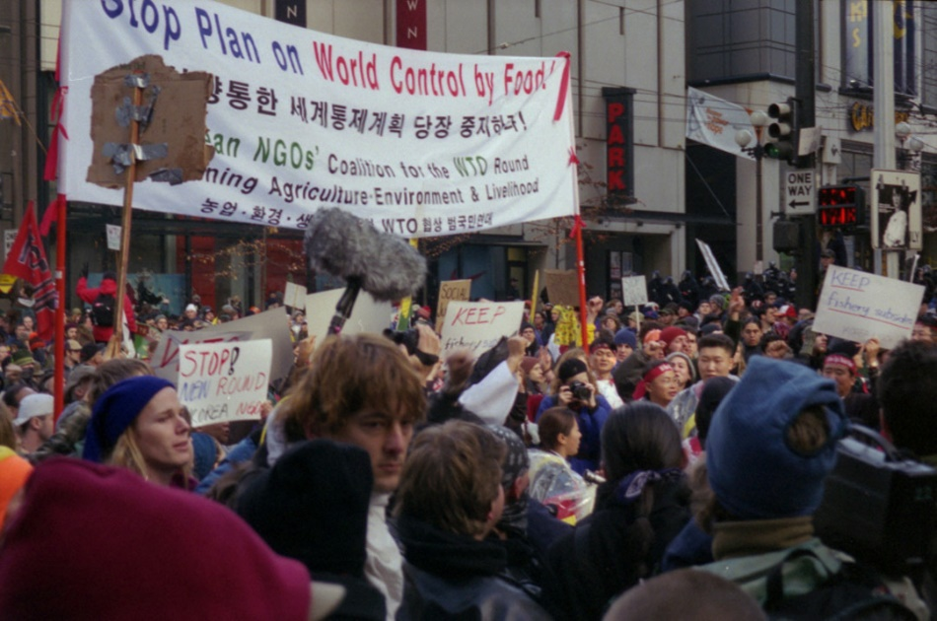
Earliest example: WTO Protests of 1999
“The Battle of Seattle”: Protest against globalization pact
Grassroot mobilization from various countries
Mainly affected class: farmers, factory workers, environmentalists, etc
No major financial sponsors
Organized about travel, placement and other logistics through emails and boards
Coverage of causes done extensively through online alternative media (example: Indymedia)
Because mainstream media only showed unruly violence.

Slide 27
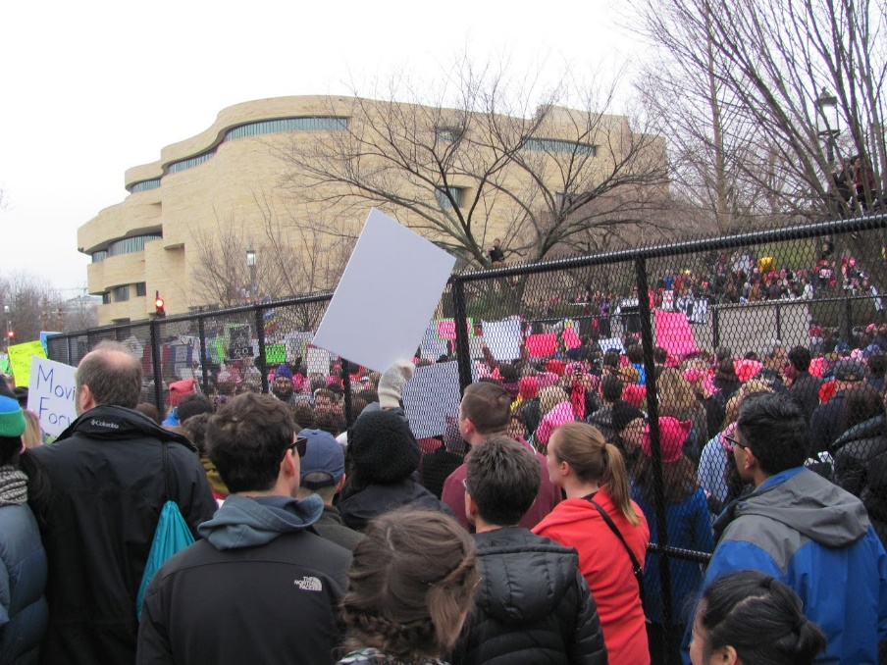
More recent: 2017 Women’s March
In protest to the anti-women’s rights policy positions and rhetoric of the newly elected president Trump.
Rapid large-scale organizing
Elected: Nov 9. 2016. Inauguration: Jan 20, 2017.
Worldwide protests: Jan 21, 2017.
470k in DC alone; 5.24 mil in the US; 7 mil globally.
Mobilizing diverse existing organizations, as well as intensive grassroot campaigning going viral.

Slide 28
The Dark Side: Populism
Populism as a trend
Definition: a political position that the will of the people should directly be enacted, without hindrance from established political systems.
Different from direct democracy, in that it opposes systemized procedures as anti-people.
Increased trend in many countries during the 10s
Political solutions to issues become harder to achieve, especially in advanced democracies.
Globalized economics pushed vulnerable classes to faux-nostalgia, anti-immigration diversity, and even ethno-nationalism.

Slide 29
Populism’s wet dream: digital spaces as…
Alternative to “elite” media
Case: the famous “media has a liberal bias” myth
Unfettered free speech of the people
Because I’m a people so whatever destructive ideas I have must be right.
Organizing ground for populist movements
If it works for other grassroots as well, why not.
Cases in point: MAGA. Brexit. Far-right govs elected in many places.

Slide 30
Where Do We Go From Here?
eDemocracy: more than having just the technology
Public sphere: good moderation needed
Networked action: reviewing goals, looking for longevity

Slide 31
Next week:
Prosumption, or the idea that we consume by creating (and vice versa)

