Slide 1
Intellectual Property
Media Law and Ethics Week 6
PSH COMM 458 SP23
Nakho Kim

Slide 2
Debate of the Week:
Canonicity of the Derivative
Should the original creator have the decision power on the derivative stories, using IP regulations?
  Case: Doyle estate sued Netflix for the non-canon depiction of Sherlock Holmes in Enola Holmes (2020)
  Case: all Star Wars derivatives (“extended universe”) became non-canon after sale to Disney (2014)
Pro: Yes, the original creators built that world.
Con: Not once it became a broader culture.

Slide 3
Definitions and types
Copyright-related laws
Exemptions
Alternatives

Slide 4
Defining Intellectual Property
Why IP?
  The P
  The I
Legal grounds: Constitution Article I, Sec 8
  (i.e. powers of Congress)
  Congress shall have the authority “[t]‌o promote the Progress of Science and useful Arts, by securing for limited Times to Authors and Inventors the exclusive Right to their respective Writings and Discoveries”

Slide 5
Types
Trade secrets (state law): practice
Trademarks (fed / state law): recognition
Patents (Cons): application
Copyrights (Cons): replicating creation

Slide 6
Trade secrets
Law: Economic Espionage Act (1996)
  Criminal offense to steal trade secrets
  FOIA has exemption for trade secrets
Duration
  Indefinite
Types
  Formulas, plans, processes, devices, and compounds…
Condition
  Has commercial value by virtue of the fact that it gives the owner a business advantage
  Known only to those individuals who have a need to

Slide 7
Trademarks
Law: Federal Trademark Dilution Act (1995)
Types
Duration
  Indefinitely, if extended through “Declaration of Use”
How it is granted
  Filed at the Patent and Trademark Office (easier than patent)
Condition
  Not already taken

Slide 8
Trademark Dilution case: Moseley and Moseley v. V Secret Catalog, Inc. (2003)
  https://web.archive.org/web/20150414233112/http://www.sptimes.com/2002/11/17/Worldandnation/Victor_vs_Victoria.shtml
  Victor’s Secret => Victor’s Little Secret
  Verdict: Requires proof of actual dilution (not mere “likelihood”)

Slide 9
Patents
Law: Patent Act
Types
  Utility, plant, design
Duration
  17yrs => 20yrs (after 1995)
How it is granted
  Via filing and vetting, U.S. Patent and Trademark Office
Condition
  Needs to be novel (“the subject matter as a whole would have been obvious at the time the invention was made to a person having ordinary skill in the art.”)

Slide 10
Patent infringements
  Remedied w / permanent injunction; tested.
    Plaintiff must have suffered irreparable injury
    Remedies at law are inadequate to compensate
    In balancing the hardships, a remedy in equity is justified
    Public interest would not be disserved
  Hence, often settled out of court.
  Case: Apple Inc. v. Samsung Electronics Co. (2011)

Slide 11
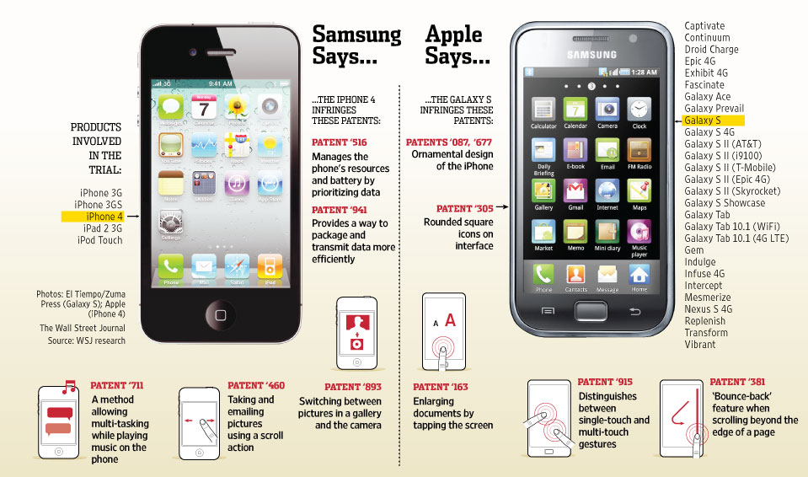

Slide 12
Copyrights
Laws: federal statutory
  Copyright Act of 1909
    Patched repeatedly with new media tech
  Copyright Act of 1976
    Duration extended, criteria clarified
  Digital Millennium Copyright Act (DMCA) of 1998
    Internet considered; circumventing protection is criminalized
    Unwitting intermediaries are exempted from liability (§ 512)
      AS LONG AS they adhere to takedown requests
        https://www.dmca.com/FAQ/What-is-a-DMCA-Takedown

Slide 13
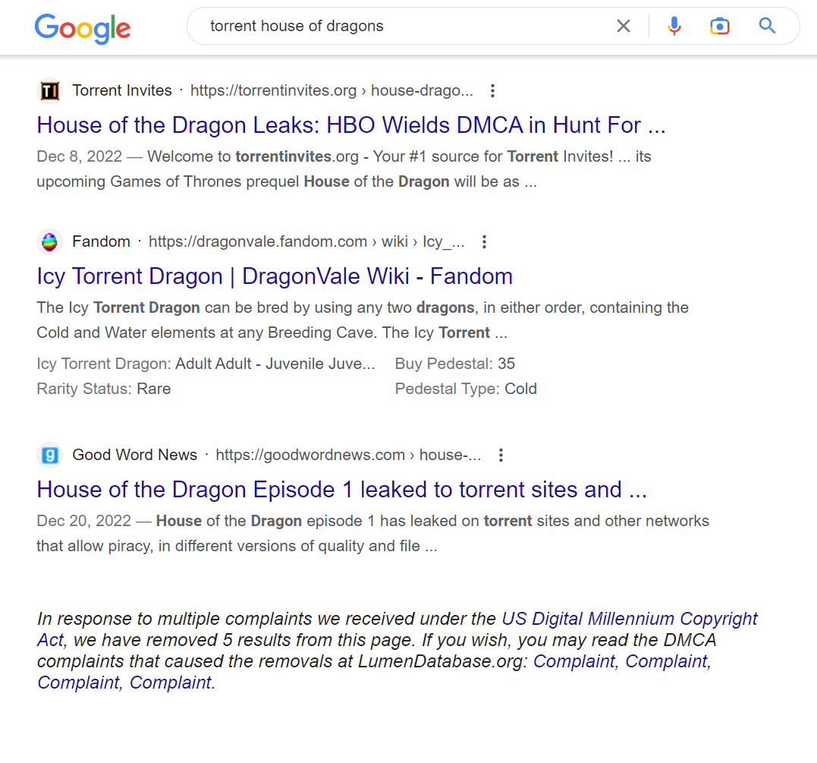

Slide 14
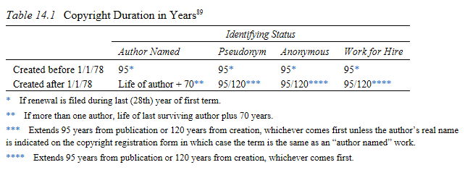
Duration
How it is granted
  Automatically with the creation, to the creator(s) unless work for hire
Conditions
  Just original expressions (not reproductions, not (unformulated) ideas (sec 102b))

Slide 15
Exclusive
  Reproduction
  Preparing derivative works
  Distributing copies
  Performing publicly
  Displaying publicly
  Performing by digital means
Copyright OF derivative work?
  Uses another’s copyrighted material, adds one’s own
Ownership (of a medium) does not equal copyright
Plagiarism does not equal copyright violation

Slide 16
[Cases in Point]
Generative AI: copyright infringement?
  Or rather, plagiarism?
Recording movies from webstream: cp. i.?
  Is it copy protection circumvention?
  Or rather, personal use?
NFTs: copyright protection?
  Or just a vanity thing?

Slide 17
Criminal persecution?
  Per 17 U.S.C. 506(A) (1992), the government must demonstrate
  A valid copyright was infringed by the defendant willfully,
  For purposes of commercial advantage or private financial gain,
  More than 10 copies in 180 days with retail value >$2500 (*used to be 1k), OR distribute a copyrighted work. (18 USC 2319)
    Up to 10 yrs, or $250k, or both.
  Attempts = completed acts.

Slide 18
Works Not Protected by Copyright
Ideas not fixed into an expression i.e. tangible creative product
Any work of the US government
Works consisting wholly of common information
Mere fact itself
Public domain works, i.e. copyrights not existing or expired

Slide 19
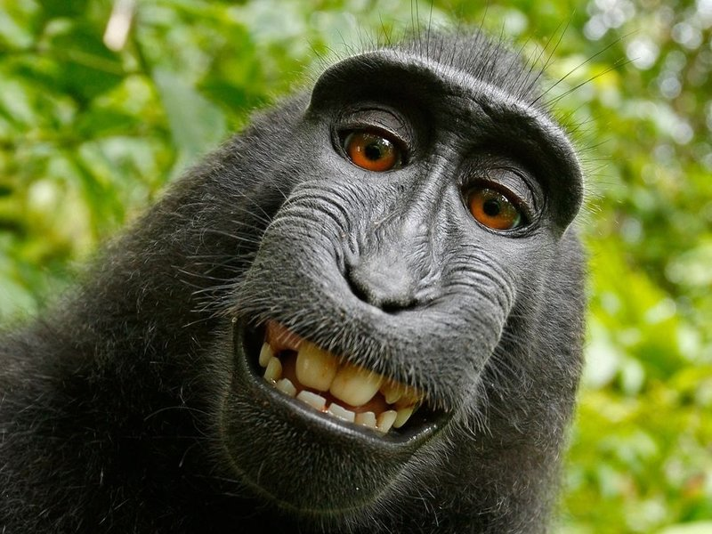
Case: Monkey Selfie (2015)
  https://www.npr.org/sections/thetwo-way/2017/09/12/550417823/-animal-rights-advocates-photographer-compromise-over-ownership-of-monkey-selfie
  PETA sued photographer “on behalf of” the monkey
  Settled out of the court

Slide 20
Spectrum of Copyright Use
(more closed)
Fully exerting copyrights
Fair use: exemptions to copyrights
Alternative copyright: pre-permissions
  Creative Commons
  GNU and the “Copyleft” movement
Public Domain
(more open)

Slide 21
Public Domain
All things not copyrightable
All things that ran out of copyright time
Free to use whenever however
The catch: beware copyrighted expressions of public domain content

Slide 22
Fair Use
Legally safe conditions for using copyrighted material without attaining license
Why?
  To skip the lengthy process, if obviously used to further Arts and Sciences
    …under conditions where public interest balances out commercial opportunities.
    Specific tests include: (see diagram, lower left corner)

Slide 23
In a nutshell:
Communicating ABOUT that IP,
without doing business THROUGH that IP
E.g. reporting, research, education, critique, parody... in limited amounts.
  Parody/homage: inspired or derivative?
NOT remixing, streaming on Youtube, fanzine, BGM for your movie, etc

Slide 24
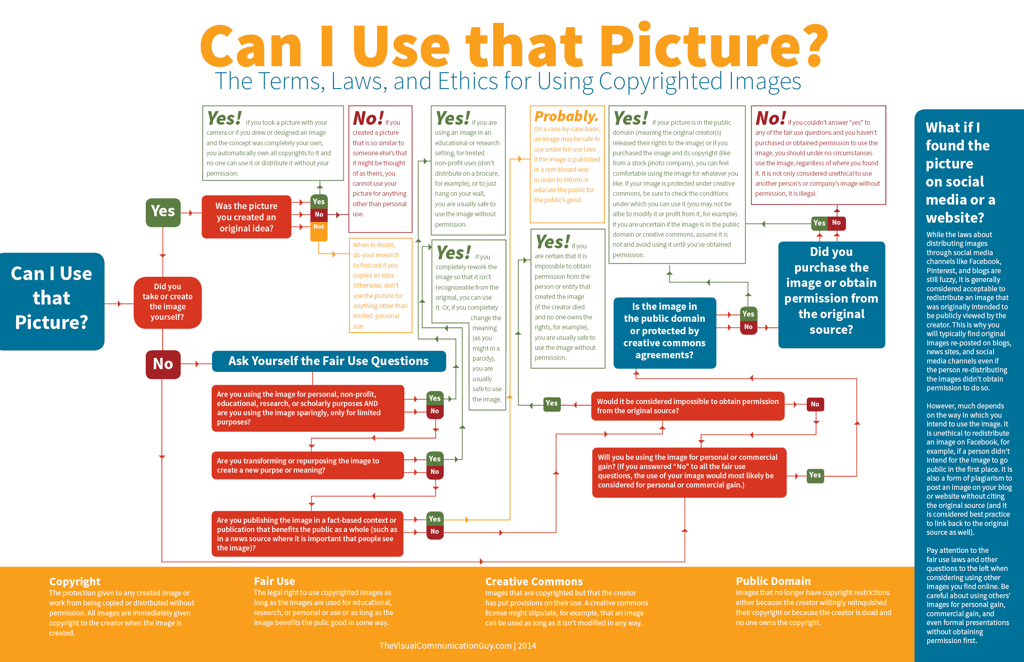

Slide 25


Alternative Copyrights
Copyleft Movement
  “Requiring all modified and extended versions of the program to be free as well.”
  Example: Richard Stallman and GNU

Slide 26
Creative Commons
  Alternative copyright movement started by Lessig et al, 2001
    Along with a non-profit org.
  Purpose: encouraging creative remix, while also providing levels of control

Slide 27
  A set of pre-defined licenses
    Read https://creativecommons.org/licenses/ for all combinations
    1 fixed condition: Attribution
    3 elements: ShareAlike, Derivative, Commercial
  3 layers applied
    Legal code, human-readable (‘deed’), machine-readable
  Popularized through popular UCC services
    Flickr, Soundcloud, Youtube, etc

